Slide 1
Understanding of SASSIE Structure
Cheol Jeong, Joseph Curtis
07.15.2016

Slide 2

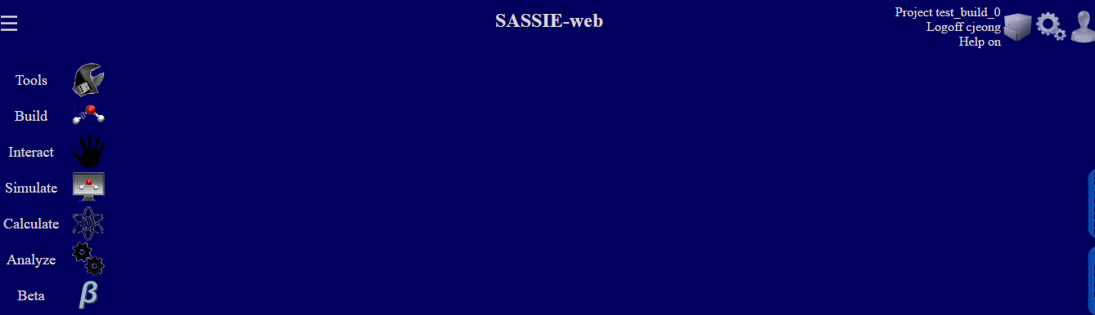
What is it with sassie?
Tools
Builds
Interact
Simulate
Calculate
Analysis

Slide 3
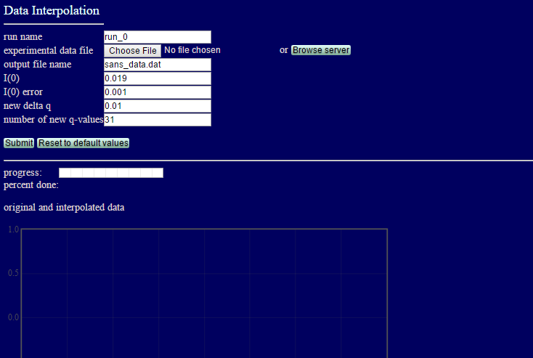

A Module for Players

Slide 4

I needed to know hierarchical (data, file, module,…) structures as a coach (developer).
Inventory mapping, management and list.
Analysis for branch 1.0.

Slide 5
Map I. Module Map shown in Web
SASSIE-web
Tools
Contrast Calculator
Align
Data Interpolation
Extract Utilities
Merge Utilities
Builds
PDB Scan
Interact
Molecular Viewer
Simulate
Monomer Monte Carlo
Complex Monte Carlo
Energy Minimization
Torsion Angle MD
Two-Body Grid
Calculate
Crysol
SCT Calculate
SCT Optimize
SLD MOL
EM to SANS
Analysis
Chi-Square Filter
SCT Analysis
Density Plot
APBS
A job submission:
using a module.
No interaction between module in a job

Slide 6
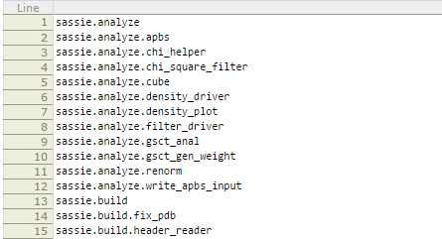
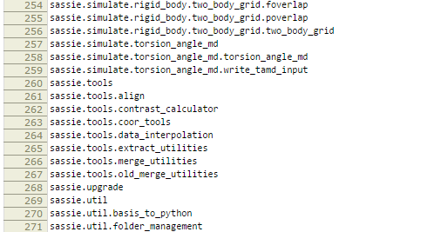
Map II. Python Module Structure (1.0)
module_str.txt

Slide 7
Map III. File Structure (1.0)
SASSIE
tools
contrast_calculator.py
align.py
data_interpolation.py
builds
pdbscan
interface
…
simulate
Monte Carlo
constraints
energy
mdx
namd
calculate
analysis
sasmol
util
scripts
gui
core_testing
header_reader.py
pdbscan_utils.py
monomer
complex
ds_dna_monte_carlo
openmm
rigid_body
torsion_angle_md
Need mapping a module to file structure.

Slide 8
Summary
Inventory mappings in different levels.
The maps will lead to inventory lists.

