Slide 1
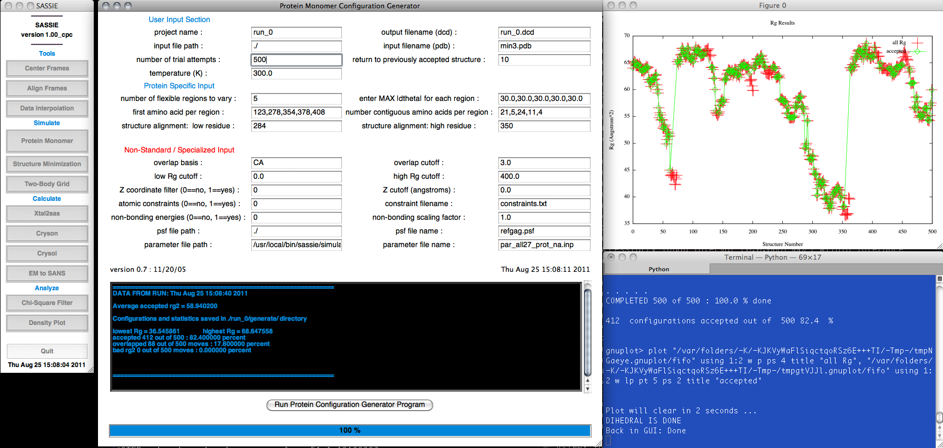
SASSIE
A Program to Calculate Scattering from Atomistic Models of Biological Systems
Hailiang Zhang
Nicholos Clark

Slide 2


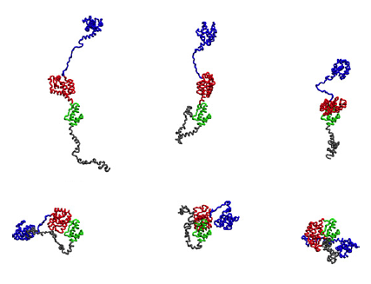
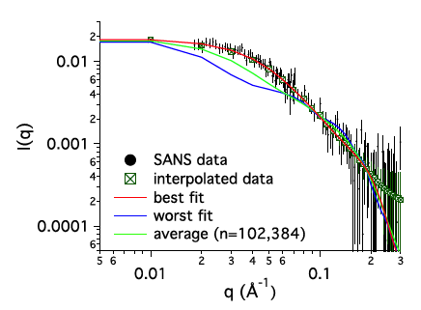
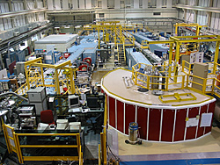
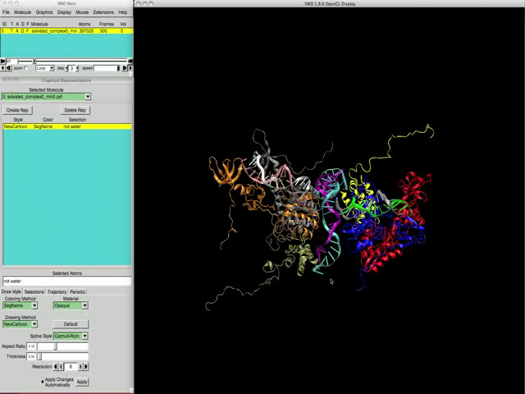
Goal and problems
Structure & Dynamics
Neutron Experiments
Time and length scale not accessible by traditional MD
User bottlenecks & barriers
  Coordinates and file handling
  Scattering calculations (Coh, Incoh)
  Limitations of “black-box” applications
Notes:
A primary goal of SASSIE is to provide our neutron facility users some tools to bridge the neutron experiments and the structure AND dynamics of biological molecules. We realize that a big portion of the samples from our biological community users are generally quite large and flexible biological systems, which may have very large scale collective motions. This requires an efficient phase sampling method to cover the conformational space as much as possible.
Apparently, for large biological systems, its large time and length scale is generally not accessible by traditional MD method. For example, this is a 1ns MD simulation for HIV-integrease that binds to a DNA molecule. From this movie, we can find that MD simulation only covers a small range of the conformational space even though the calculation may take 2 weeks on a 8-core CPU.
Moreover, there also exist some bottlenecks and barriers from the users’s side. For example, the users must be very careful about the different coordinates and file formats, otherwise they might cause some problems. Moreover, some “black-box” applications and scattering calculation tools may have some limitations and may become very misleading.
Backup for questions:
HIV integrease MD (400K atoms): 1ns 13days 8core CPU
Super computers: 100K atoms: 50ns, 1 month (replica exchange: feasible for 20K atoms on 1000-nodes clusters)
Our user group may not have experience/access/designer for super computers
NOTE: The MD simulation doesn’t introduce too much inter-domain fluctuation. It is a 400K atoms system solvent not shown.

Slide 3
A solution: SASSIE
Structure & Dynamics
Neutron Experiments
Developed to enable NCNR user community to efficiently develop molecular models for the neutron/X-ray scattering/reflectivity experiments.
Provide support to on-going collaborations with an eye towards code-reusability and modularity.
Prototype
Beta
Refactoring
CPC release
2005
2009
2011
www.smallangles.net/sassie
Joseph Curtis et al, SASSIE: A program to study intrinsically disordered biological molecules and macromolecular ensembles using experimental scattering restraints. Computer Physics Communications, 2012, 183(2), 382–389
Notes:
Regarding these problems, we developed SASSIE to enable…
It will support the on-going collaborations but we also keep eyes towards…
The prototype of SASSIE was written in 2005, and its beta version was released in 2009 for users’ test, and after that, the code has been re-factored quite a lot to make the software more comprehensive and powerful. Very soon, we are about the release the later version of SASSIE, which is SASSIE version 1.0, and the users are encouraged to visit the following website for the latest release information, and you can also welcome to post your questions and comments in the discussion boards.

Slide 4
SASSIE
Software to streamline the process of generating bio-molecular structure ensembles and scattering profiles; results are subsequently filtered against experimental scattering data.
It provides generic tools for molecular operations, calculations, data analysis and optimizations.
It is a collection of Python and C/Fortran subroutines with a TCL/TK graphical user interface (GUI).
Framework to enable code re-use.
Notes:
So, what is really inside SASSIE?

Slide 5
Why SASSIE?
Enable users to ask “what if?” questions and get fast answers
Fast
    Fast sampling: MMC (CHARMM FF)
Notes:
Now, what makes SASSIE standing out?
First, SASSIE allows users to ask “whatif” questions and get fast answers before they forgot what the question was. This is very beneficial for the experimental design and post-analysis.
This requires SASSIE to use fast and efficient methods.
First, SASSIE has a fast conformational space sampling module by using MMC based on CHARMM force field. Let take a look at HIV-integrease again. The blue map over here shows the conformational space which covered by 1ns MC simulation which takes 2 weeks.
For ergodic systems, the “time-average” of a quantity calculated by MD is equavalent to the “ensemble-average” of the same quantity as calculated by MC.

Slide 6
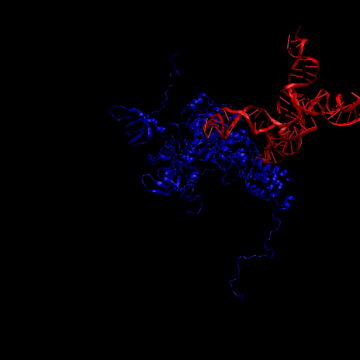
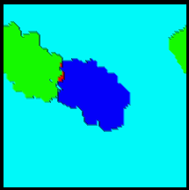
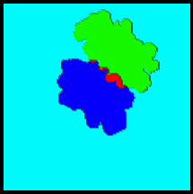
Why SASSIE?
Enable users to ask “what if?” questions and get fast answers
Fast
    Fast sampling: MMC (CHARMM FF)
    Fast docking: FFT
Ephraim Katchalski-katzir et al. Proc. Nati. Acad. Sci. USA, 1991, 89, 2195
Notes:
For the complex, SASSIE has a FFT-based fast docking module which will rapidly screen for the conformations based on surface recognition.
(Two 2D mesh plot instead of the correlation peak plot)

Slide 7
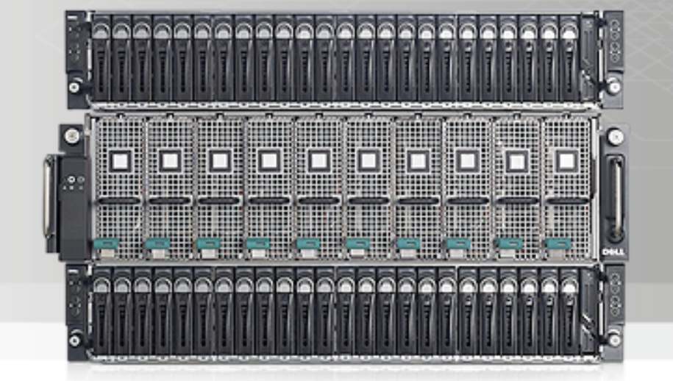
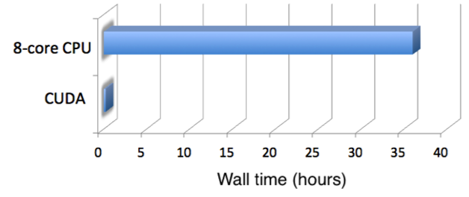
Why SASSIE
Enable users to ask “what if?” questions and get fast answers
Fast
    Fast sampling: MMC (CHARMM FF)
    Fast docking: FFT
    GPU
300X
Notes:
Also, we are in the middle of developing the CUDA code to do the very fast coherent and incoherent scattering calculation on GPU clusters. It dramatically saves the computational time by giving almost identical results within the machine precision.

Slide 8
Why SASSIE
Enable users to ask “what if?” questions and get fast answers
Fast
    Fast sampling: MMC (CHARMM FF)
    Fast docking: FFT
    GPU
Modular and Extensible
Flexible
  GUI or script accessible.
  Python modules/APIs for molecular manipulation/calculations.
Versatile
  Monte-Carlo generation / MD trajectories
Notes:
Each module can be either accessed through a GUI interface or through a stand-alone script er w/o the GUI.
…
Finally, SASSIE is also very versatile. It can either do the modeling by generating the structure ensemble itself by MC sampling or based on the given MD trajectory.
GUI/script: each module can be excuated as stand-alone

Slide 9
What does SASSIE do?
Simulate
Protein/ss-NA
Complexes
Calculate
Xtal2sas
Cryson
Analyze
Chi-square filter
Grid sampling
FFT docking
Energy minimization
Crysol
Hydropro
SLD (NR)
Monte-Carlo optimization
EM2SANS
MES
Tools
Alignment
Data interpolation
Density plot
Notes:
The current version of SASSIE is mainly composed of 4 sections.
It has tools to do the preparation work the structure and experimental data;
it can do the conformational sampling protein, ss-NA and its complex by different algorithm;
Also, it has a big variety of SAS and SLD calculator for reflectivity measurement.
Finally, it can optimize the structure ensemble by chi-square or heuristic methods.
The first frame “Tools” provide utilities to do some preparation work for the starting molecule and experimental data.
The second frame “simulate” will generate the structural ensemble for the experimental modeling. It can do…
The third frame provide multiple methods to calculate the scattering or reflectivity profile. It includes…
The last frame will used to analyze and view the modeling results. (MES: minimal ensemble structure)
Complex: protein-DNA, protein-protein

Slide 10
What will SASSIE do?
Simulate
MMC-SQ
Calculate
GPU-SAS
Tools
Builder
PMI tools
PDB-Rx
D-Lab
Interact
Open-GL canvas
Real-time scattering calculation
OpenMM (GPU)
ds-NA move sets
S-DYN (GPU)
Interactions
ΣΣsin(q*rij)
S(Q, ω)
DNA
SASSIE v2.0 coming 2013!
Notes:
In the nearest future, we are going to add more exciting features.
We can build the molecules from scratch;
We can automatically diagnose the bad structure;
We can simulate the molecular interaction;
And we can parallelize the both the pair-wise summation and

Slide 11
SASSIE testing suite
Hierarchy
Unit test
Capability
Code correctness
Automation
Nosetests
Flexibility
Testing level as required
Integration test
System integration
Machine dependency
Memory issue
Huge data file generated on the fly
Notes:
15 seconds

Slide 12
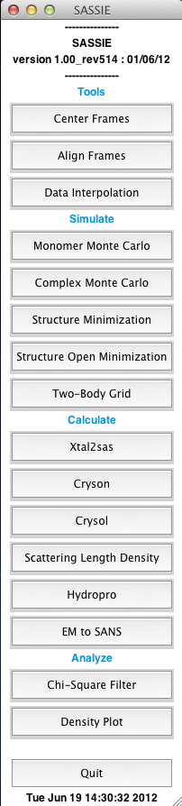
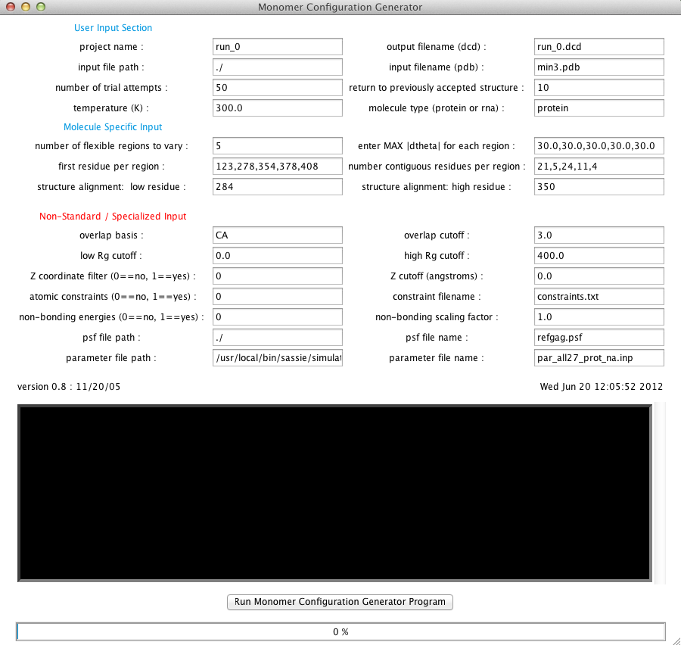
SASSIE GUI
Notes:
This is the main GUI of SASSIE when you run your program. As we said, it is composed on 4 sections and it is very modular.
…
This framework design provides SASSIE great flexibilities and makes it very adaptive for different applications.

Slide 13
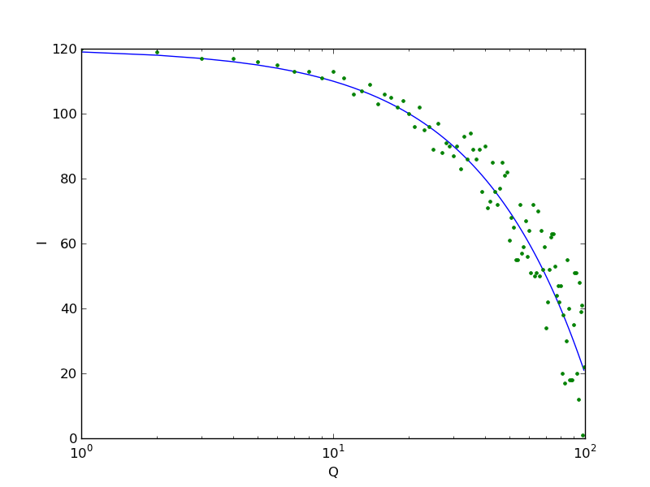
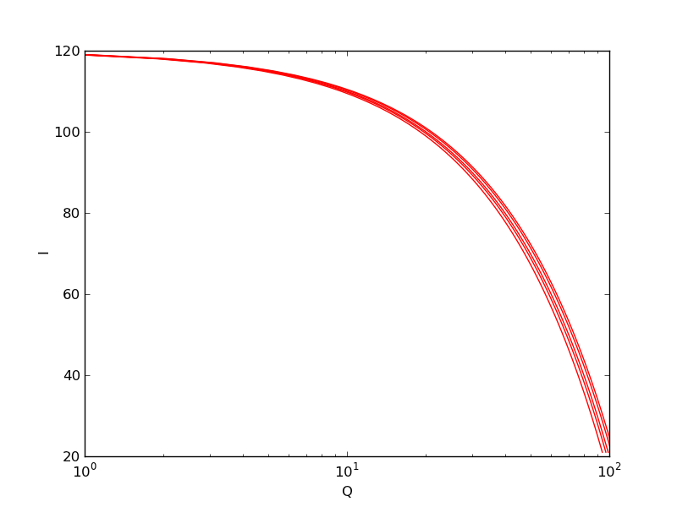

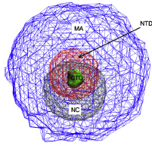
Case 1: Xtal2sas modeling from a MD trajectory
Data Interpolation
Xtal2sas
χ² fitting, density plot

Slide 14
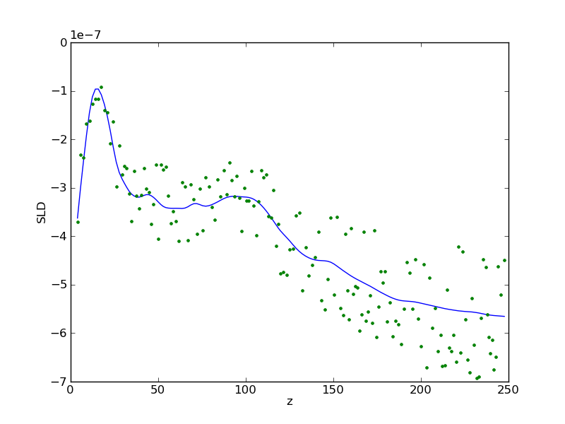
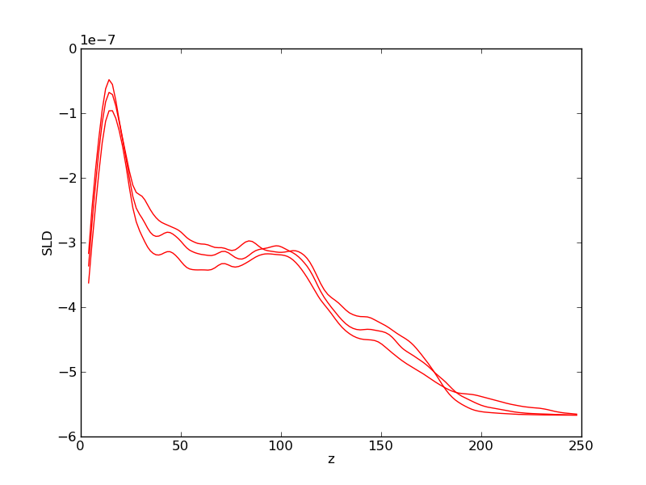
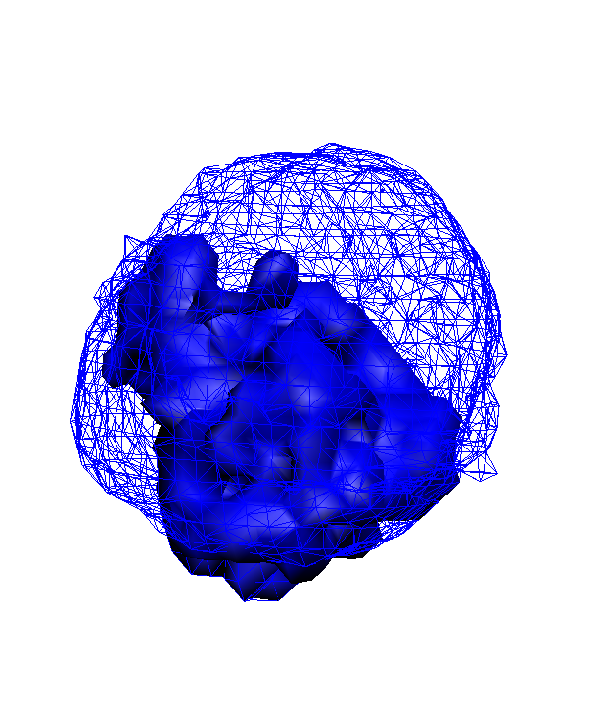
Case 2: SLD modeling from a MD trajectory
Data Interpolation
SLD
MC optimization,
density plot

Slide 15
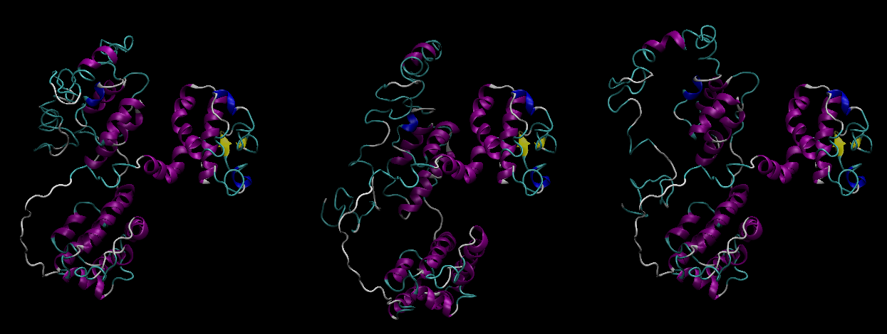
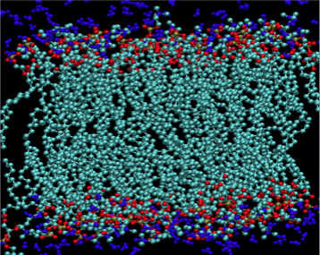
Case 2a: SLD modeling from a MMC simulation
Data Interpolation
SLD
MC optimization,
density plot
Monte Carlo generation

Slide 16
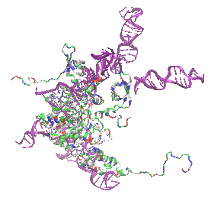
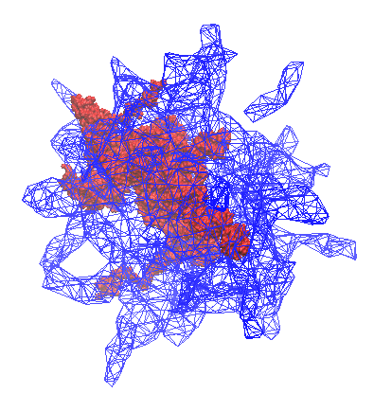
Case 3: Molecular Interactions
Data Interpolation
Cryson
χ² fitting, density plot
FFT docking

Slide 17
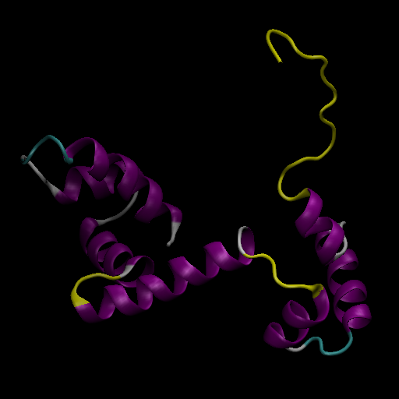
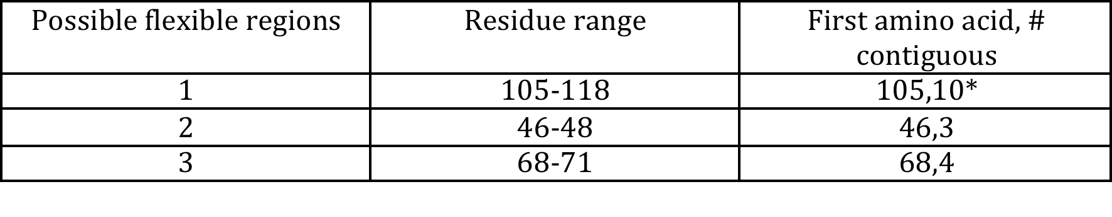
Tutorial Flowchart
Monte Carlo generation
χ² fitting
Data Interpolation
Xtal2sas calculation
Density plot
Structure Minimization
DBD
www.smallangles.net/sassie
Notes:
Next, I am gonna switch my gear and give a tutorial on the scattering modeling from a Monte Carlo simulation. We are gonna walk through the whole process step by step, but some steps may take a long time and so we may need to jump to the next step while we are waiting.
The system we are gonna work on is a protein subdomain that is part of a large system. This protein may have 3 flexible linkers

Slide 18


Developer team and acknowledgement
Joseph E. Curtis joseph.curtis@nist.gov
Susan Krueger susan.krueger@nist.gov
Hailiang Zhang hailiang.zhang@nist.gov
Katie Sarachan (NRC) katie.sarachan@nist.gov
Sindhu Raghunandan (SURF)
Harry Bullen (SURF)
NIST-ARRA
www.smallangles.net/sassie
Notes:
Next, I am gonna switch my gear and give a tutorial on the scattering modeling from a Monte Carlo simulation. We are gonna walk through the whole process step by step, but some steps may take a long time and so we may need to jump to the next step while we are waiting.
The system we are gonna work on is a protein subdomain that is part of a large system. This protein may have 3 flexible linkers

Slide 19
Collaborators and registered users
Nicholas Clark Colorado State University
James Cole University of Connecticut
Siddhartha Datta NCI-Frederick
David Fushman University of Maryland
Kushol Gupta University of Pennsylvania
Sanju Gupta University of Pennsylvania
Andrea Hamill NIST
Michael Kent Sandia National Laboratories
Ella Mihailescu University of Maryland / NIST
Arnold McAuley Amgen Incorporated
Duncan McGillivray University of Auckland
Hirsh Nanda Carnegie Mellon University
Madushi Raththagala Johns Hopkins University
Alan Rein NCI-Frederick
Mike Rodgers Johns Hopkins University
Joel Schildbach Johns Hopkins University
Robert Schleif Johns Hopkins University
Siddhartha Shenoy Carnegie Mellon University
Elizabeth Sweeny University of Pennsylvania
Tanya Sysoeva Harvard University
Nathan Wright James Madison University
95 registered users
www.smallangles.net/sassie
Notes:
Next, I am gonna switch my gear and give a tutorial on the scattering modeling from a Monte Carlo simulation. We are gonna walk through the whole process step by step, but some steps may take a long time and so we may need to jump to the next step while we are waiting.
The system we are gonna work on is a protein subdomain that is part of a large system. This protein may have 3 flexible linkers

