Slide 1
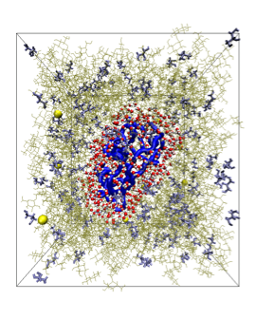
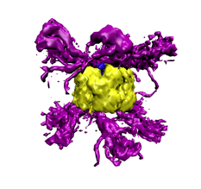
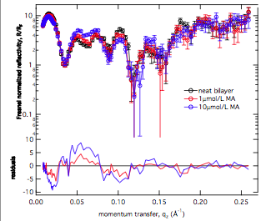
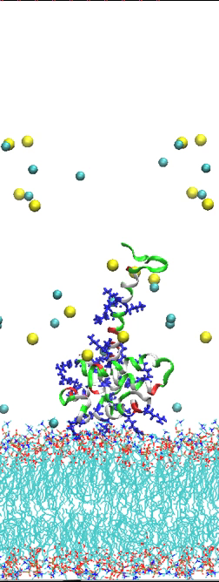
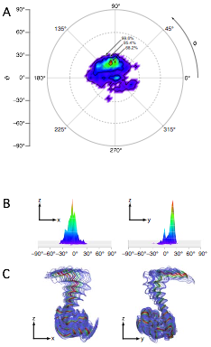
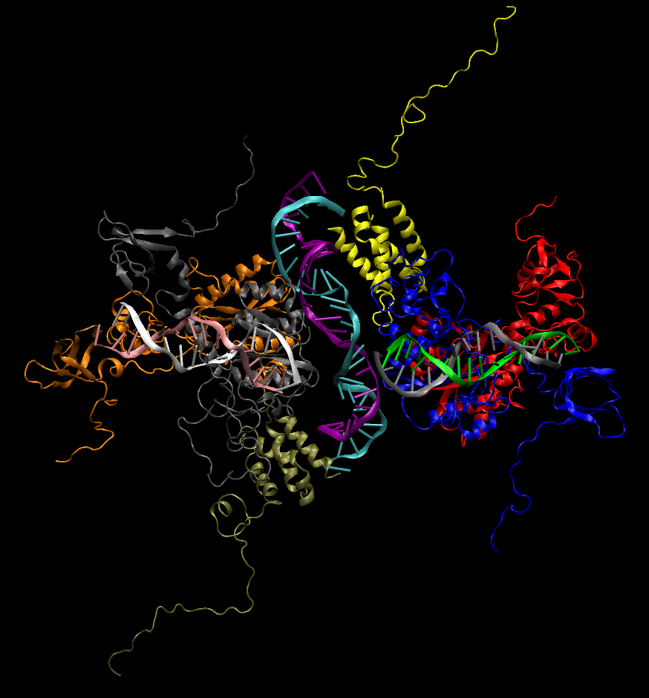
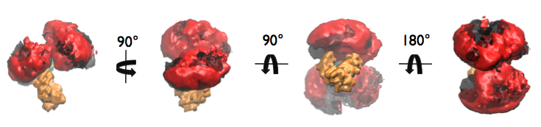
scattering (sans/saxs/nr)
  Low resolution technique
Is my model structure reasonable?
What is the shape? Is it extended or compact?
What is the orientation of my protein on a membrane? Is domain A close to domain B?
What contrast experiments could I do to determine the shapes of individual components of my complex?
What types of interactions occur? Can these be modulated? (structure & dynamics)
Majority use dummy atom models & “black-box” software that provide a single answer → no physics!

Slide 2
Sampling -vs- prediction
Since scattering is a low resolution technique (under-determined problem) and many systems are disordered or in non-equilibrium states . . .
-> the first goal is to have a representative ensemble of possible configurations and compare to experimental scattering profiles
-> then sample those configurations for physical insight
-> suggest new experiments (chemical or scattering)
Large value in ruling out pre-conceived models!
New experimental constraints will improve modeling analysis etc.
Current “simple” MC configuration space coverage is, well, random.
MD methods tend to sample locally available states

Slide 3
Figures/topics for RNA/TAMD paper
RNA as TAMD system
  structure of RNA and proposed move-set
  Plot: sampling angles to validate move-set
GAG as model system
  X² v. Rg (or density plots, etc.) for MC, MC + TAMD
  Table: RMSD comparison of: MC + minimization, MC + 1us simulation, MC + TAMD
RNA as model system (similar to #2)
Application to system with internal loop
  MD v. TAMD v. simulated annealing

Slide 4
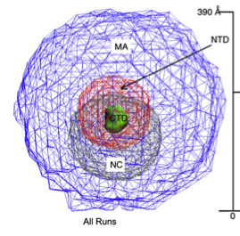
Protein MC: conformational coverage
From initial SASSIE study of HIV-gag:
100,000 MC structures
Iso-density plot, aligned by CTD domain: largely spherical

Slide 5
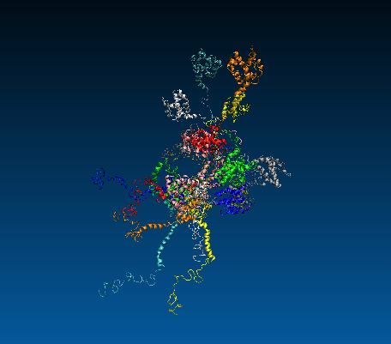
HIV-gag starting conformers for TAMD
11 conformations pulled from MC trajectory, representing range from compact → extended
Aligned here by NTD

Slide 6
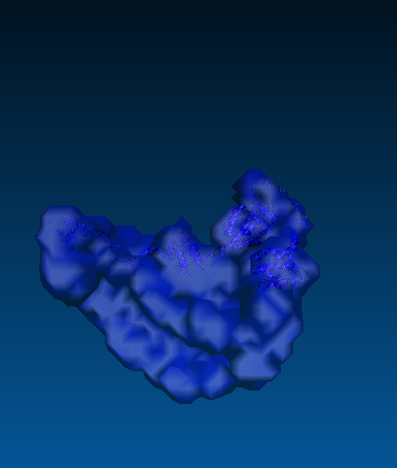
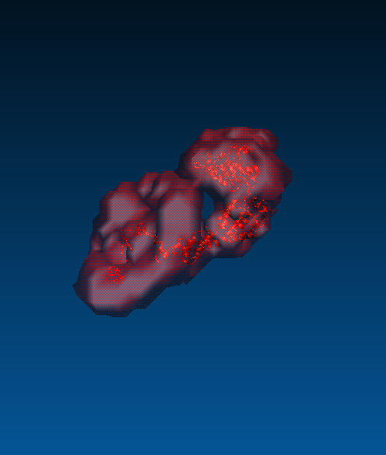
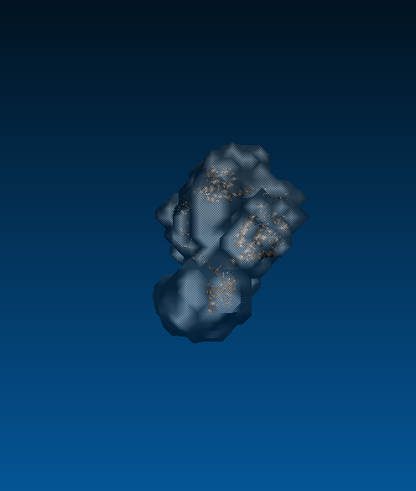
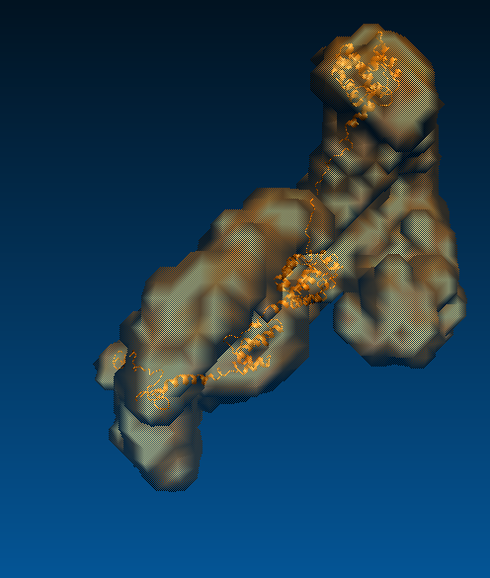
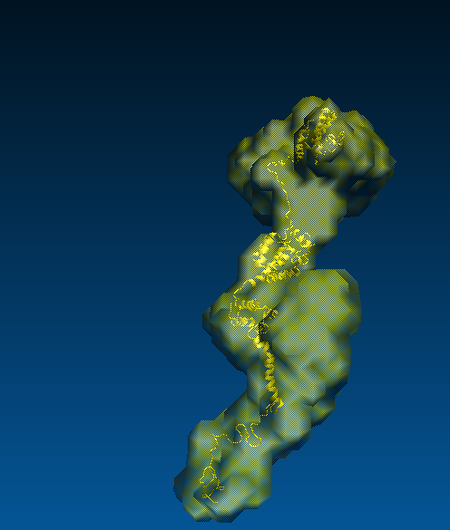
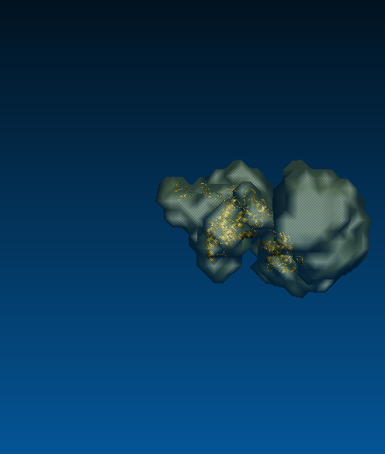
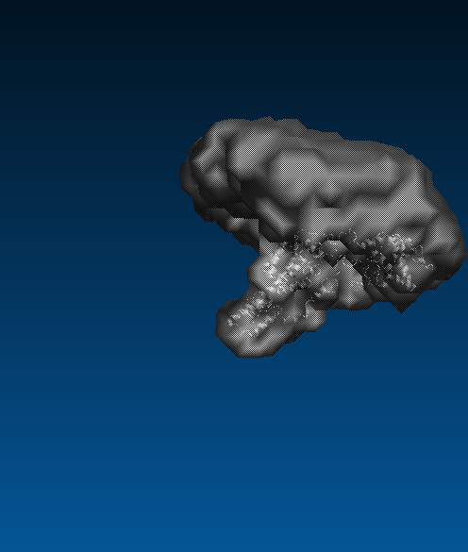
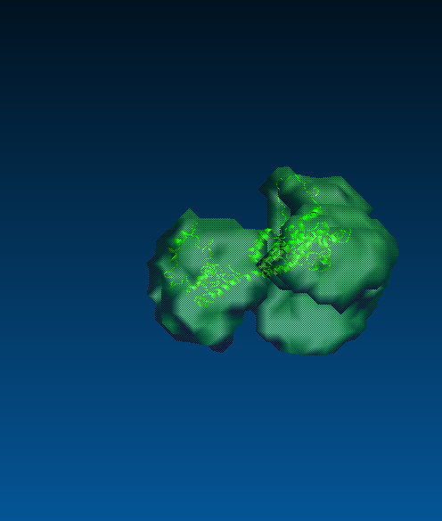
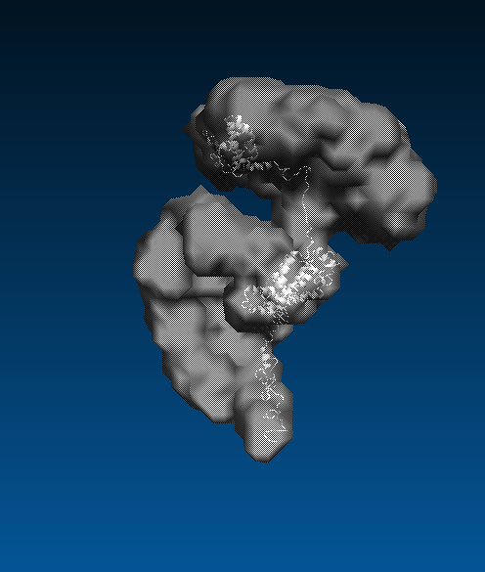
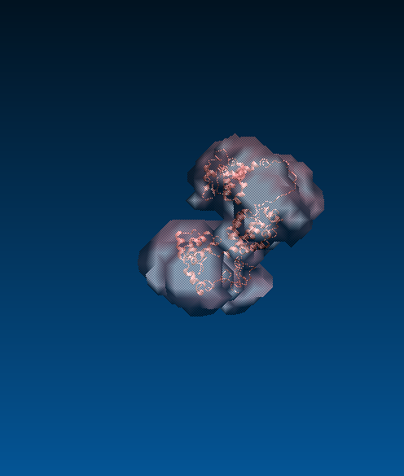
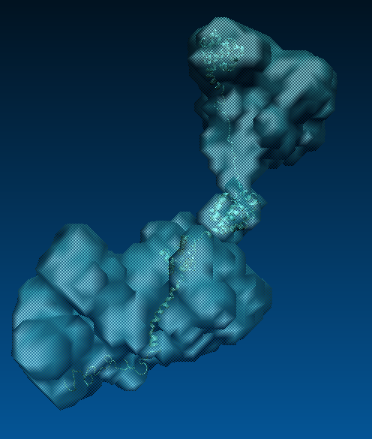
Isodensity plots of TAMD runs (500,000 0.002ps steps) from 11 starting structures

Slide 7
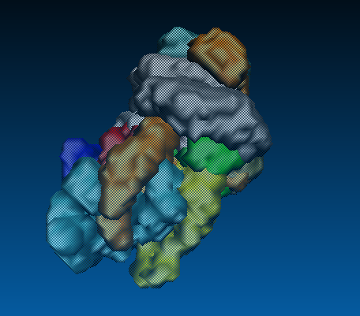
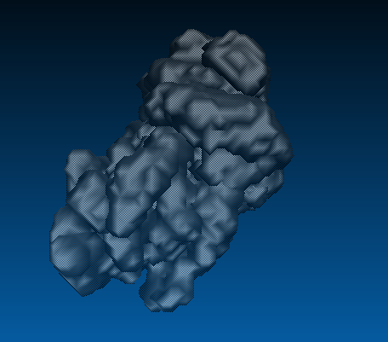
Protein TAMD: conformational coverage
Combined isodensity plots from 11 starting conformers (500,000 0.002ps steps)

Slide 8
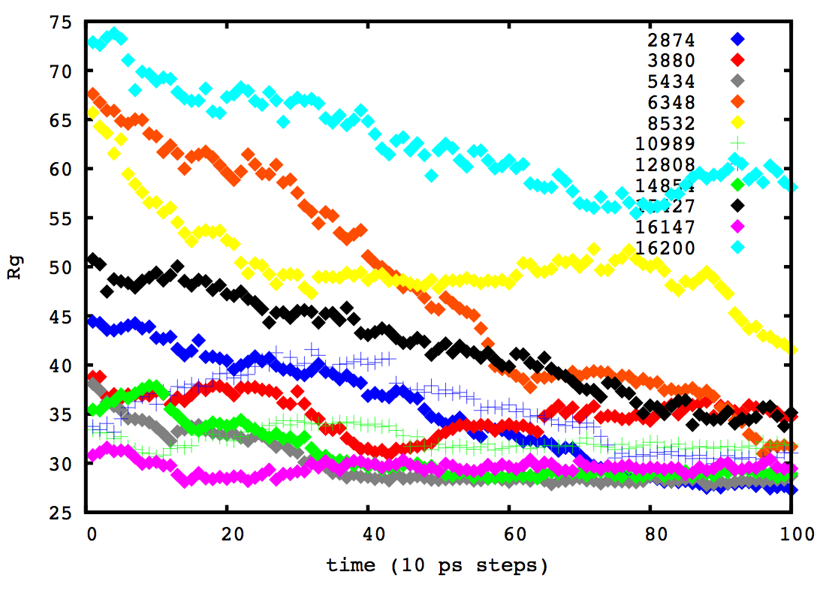
TAMD structures clearly collapse: implicit solvent model issue or real physics?

Slide 9
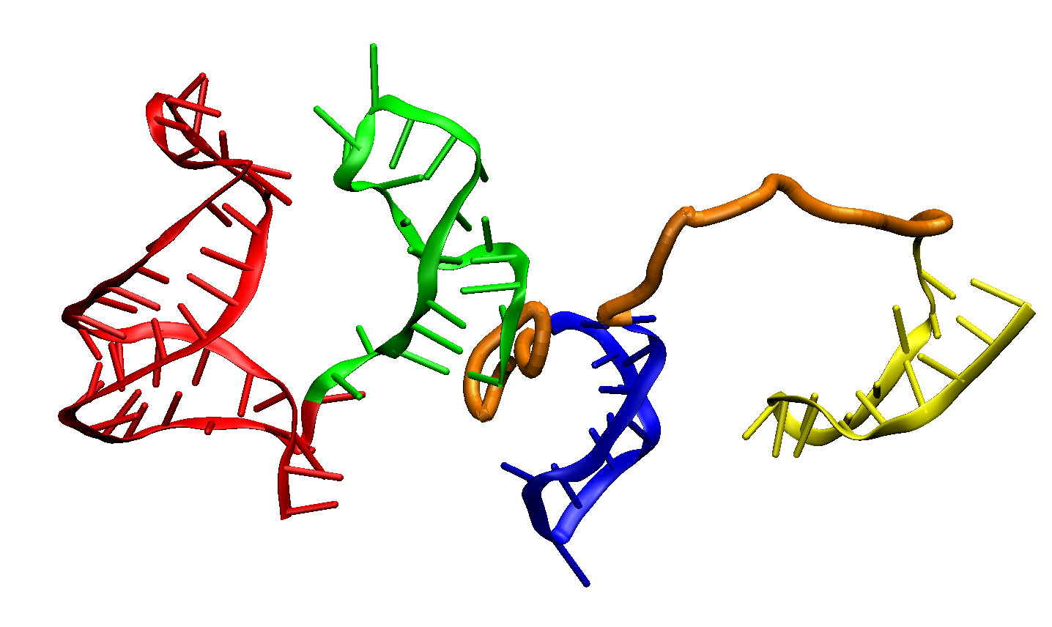
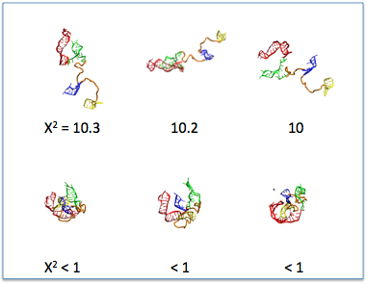
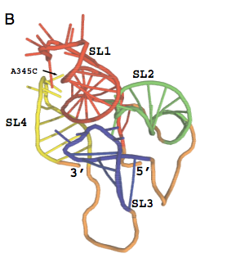
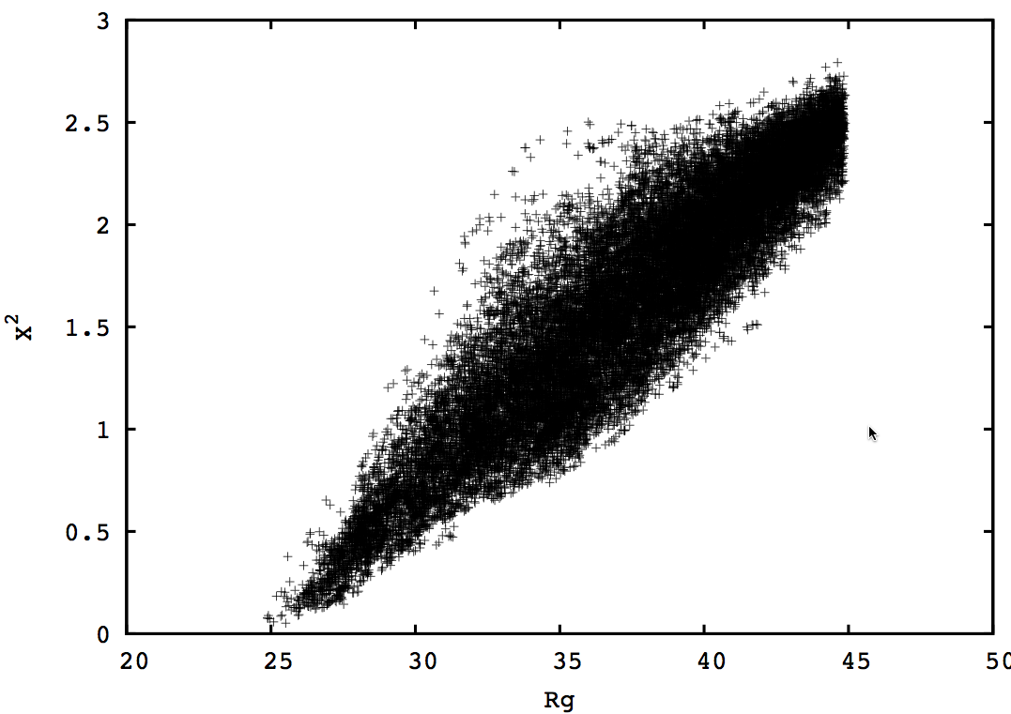
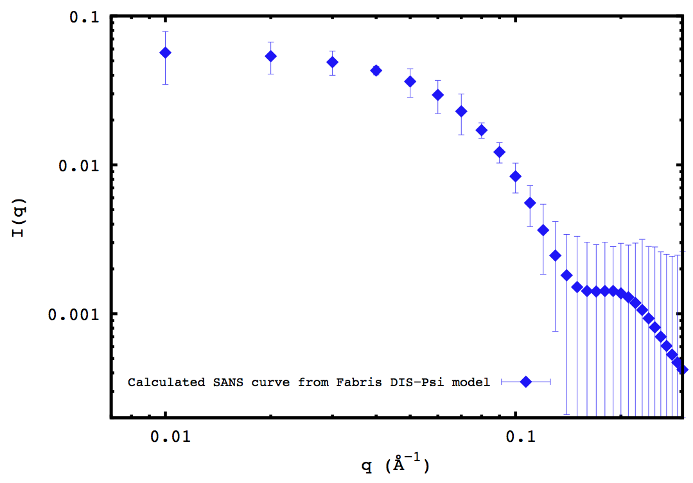
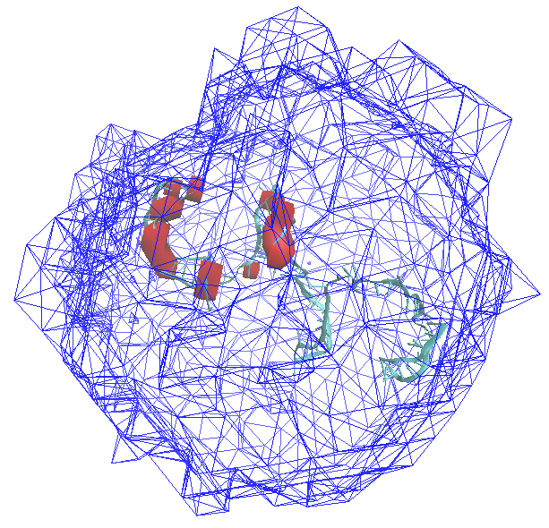
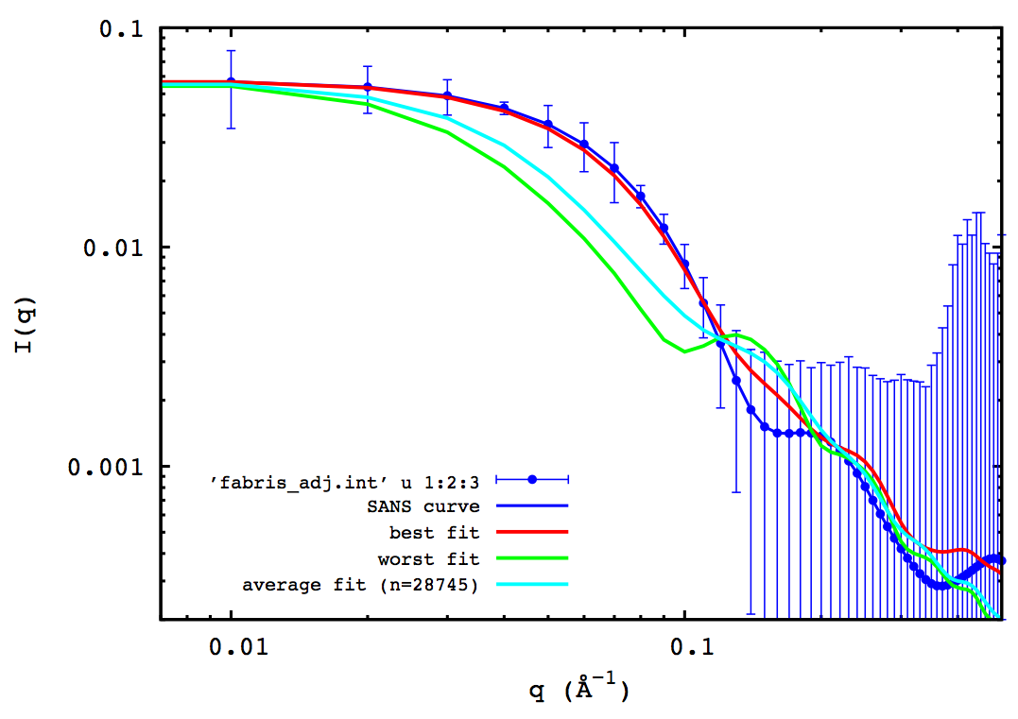
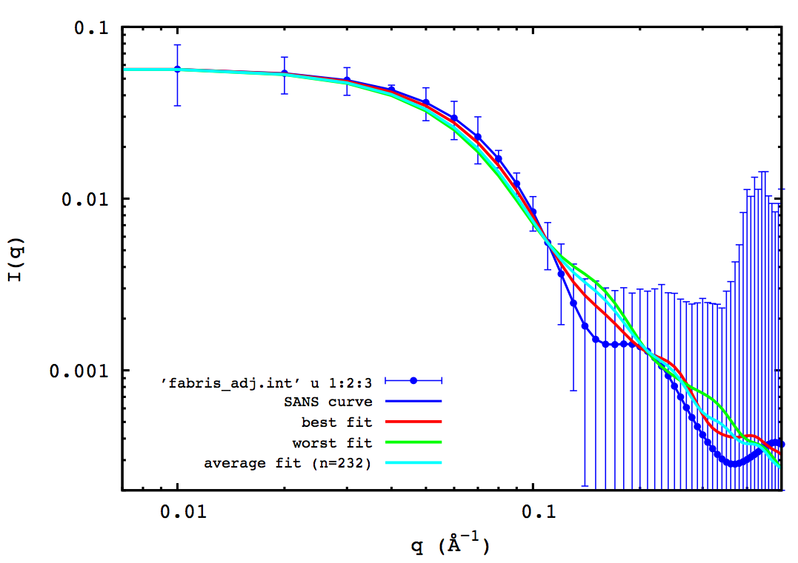
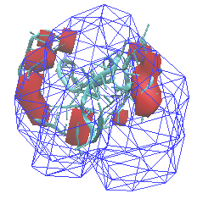
MC simulation and SASSIE study of the flexible HIV 5’ UTR DIS-Psi region
“experimental” data: calculated from the only experimental structure available
130Å
SL3-4 (blue)
SL1-2 (red)
55Å
0
All conformers
Best-fit conformers

Slide 10
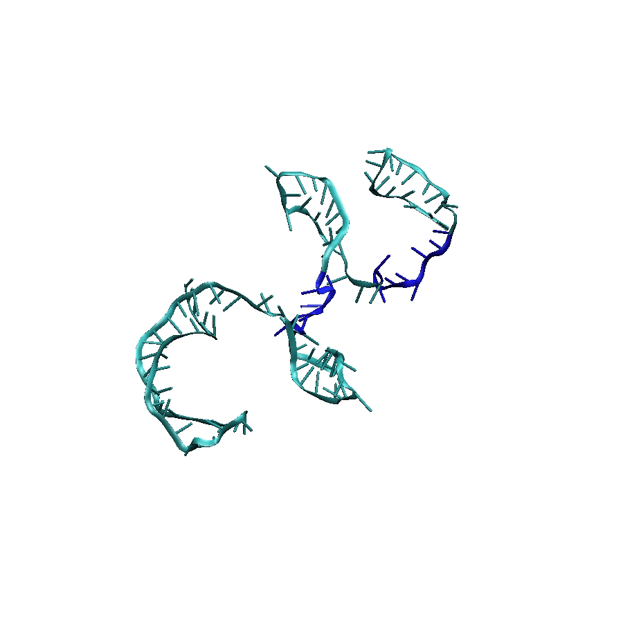
tamd: rna, rdie

Slide 11
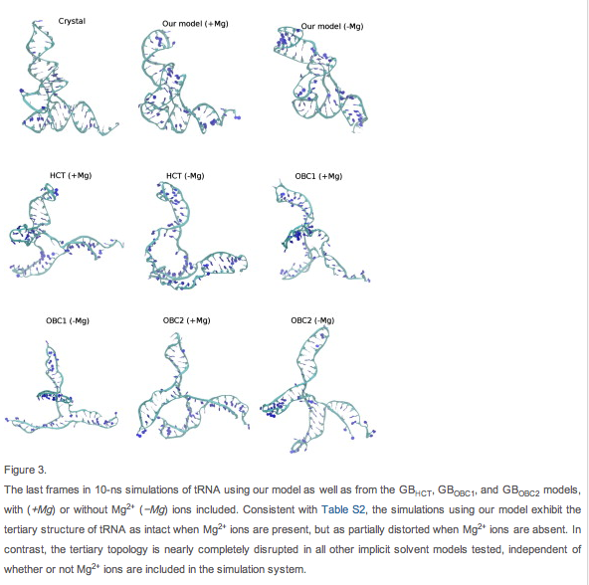
Implicit solvent plan &CCP-SAS . . .
Can we design a matrix of models and experimental
systems to carry out a “study”?
Add IS to MC code?
Focus on gag/rna (dna?) first
Long-term:
Dilute AND concentrated systems:
proteins
nucleic acids & complexes (dilute only)
lipids (micelles, nanodiscs, surfactants)
Liu et al. BPJ 105, 1248 (2013) STINKER
Prabhu et al. JCC 29, 1113 (2008) CHARMM-ZAPI

Slide 12
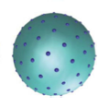
Spherical grid basis -> then local tamd?
A – B system
SAS (SANS/SAXS) is low resolution method →
“diameter” type spacing is probably adequate.
B
B
B
B
B
Systematic configuration space coverage
B
B
B
B
B
B
B
B
B
B
B
B
A
B
B
B
Drag domains or grow linkers?
B
B
B
B
Short linkers-> MC/TAMD

Slide 13
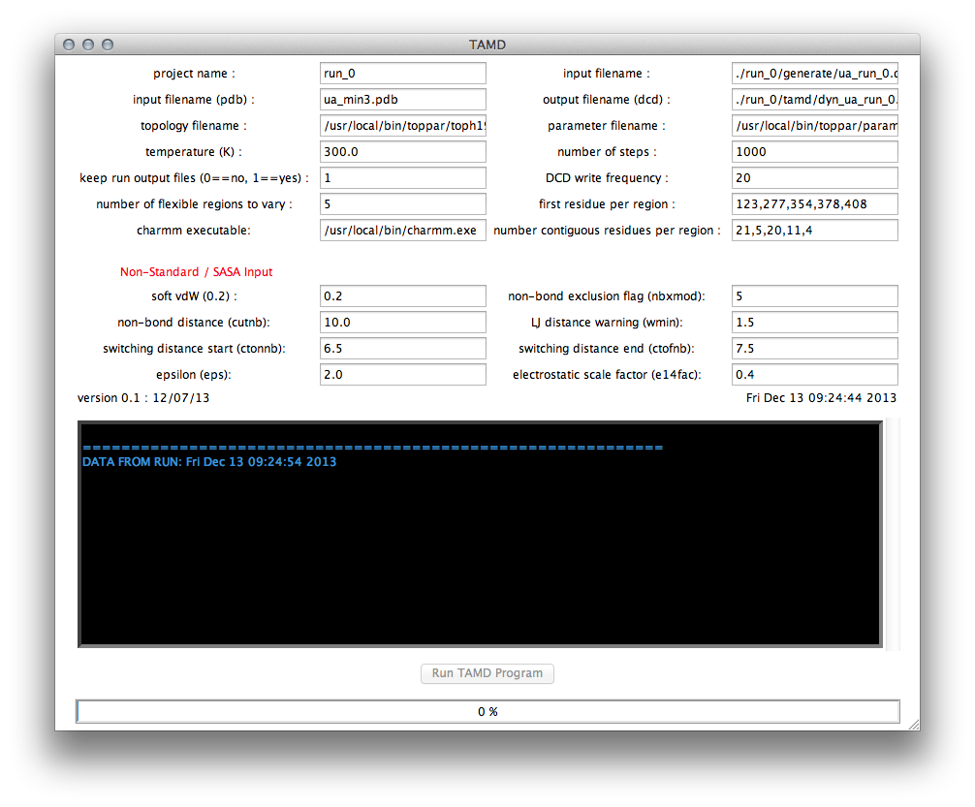
tamd gui
Requires charmm.exe $
Need scripts to generate RNA/DNA cluster definitions
Spawn 100s of serial jobs in parallel (if we mix grid/mc)
Proline (other “gotchas”?)
Bomlev → graceful exit
Tamd refactoring
Lipids? Carbohydrates?

