Slide 1
OpenMM, mdx or NAMD
March 23rd, 2012

Slide 2
System tested
Villin N68H (35 amino acids)
Gag (431 amino acids)
MCM…

Slide 3

Using NAMD Version 2.9b1
Failed…

Slide 4

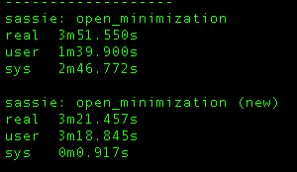

Quick code modification

Slide 5
OpenMM minimization
OpenMM
    system = forcefield.createSystem(pdb.topology, nonbondedCutoff=1*nanometer, constraints=AllBonds)
    …
    simulation.minimizeEnergy(maxIterations=100)

Slide 6
OpenMM-minimization:
Temporary location:
sassie/scripts/driver_scripts/openMM_minimization_driver.py
Usage:
import sassie.scripts.driver_scripts.openMM_minimization_driver as openMM_minimizer
openMM_minimizer. openMM_minimize(pdbFile, ffFile, steps)

Slide 7
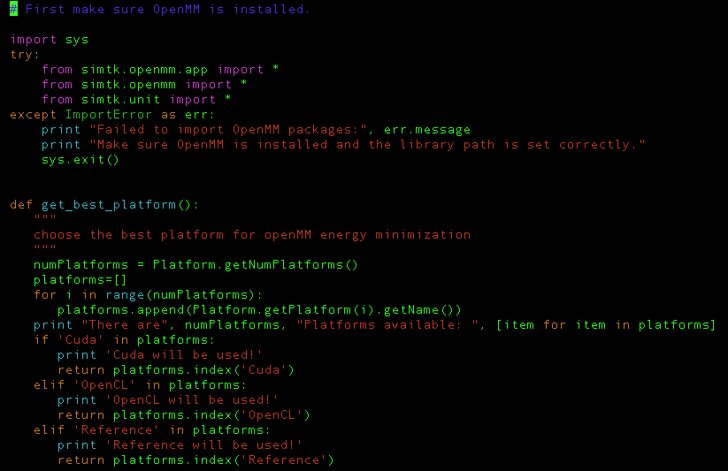
OpenMM-minimization:

Slide 8
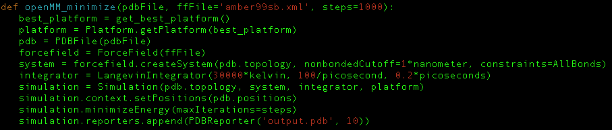
OpenMM-minimization:

Slide 9
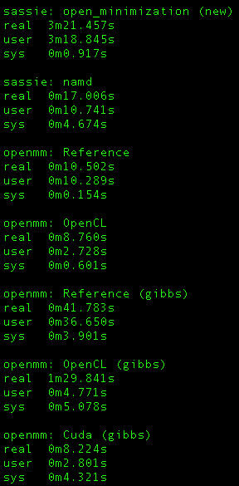
Test on villin
1000 steps
NonBondCutoff: 10A
Rigid bonds

Slide 10
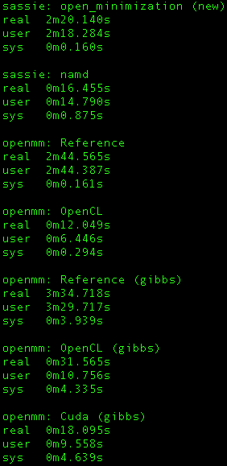
Test on gag
100 steps
NonBondCutoff: 10A
Rigid bonds

Slide 11
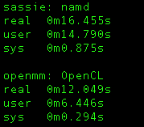
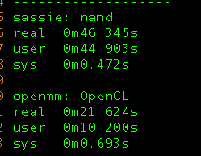
Test on gag
100 steps
NonBondCutoff: 100A
Rigid bonds
nonBondCutoff:10A
nonBondCutoff:100A

Slide 12
Questions:
Optimization parameters?
Platforms?
Optimization algorithms?
Notes:
OpenMM provides less options for parameters (no switch, exclude, and etc, and not sure about the default).
Will OpenMM “reference” use single core, multiple cores, or depend on OS?
Will NAMD use OpenCL, single core, multiple cores, or depend on OS?
OpenMM uses L-BFGS optimization algorithm for energy minimization, not sure about NAMD by defaults?

Slide 13
OpenMM architecture
Notes:
Left
The public API of OpenMM is based on a small number of classes:
A System specifies generic properties of the system to be simulated: the number of particles it contains, the mass of each one, the size of the periodic box, etc.
After the system is built, he Force objects can be added to a System and define the behavior of the particles.
Context contains all state information of the system (positions, velocities, other parameters)
Integrator includes LangevinIntegrator, VerletIntegrator, and BrownianIntegrator.
One thing very important in OpenMM is that the API cannot provide direct access to state information (particle positions, velocities, etc.) at all times…
State: a snapshot of the state of the system (for fast GPU reading in a BULK)
The public API layer consists of the classes you access when using OpenMM in an application: System; Force and its subclasses; Integrator; and Context.. These classes define a public interface but do no computation.
…
The “implementation” layer mirrors the public API classes and bridges API and and kernals.
…
The kernel implementation is contained in the last 2 layers.

