Slide 1
Free Energy Calculation
Method review

Slide 2





Free Energy Overview
MD/MC sampling
ok
?

Slide 3

Free Energy Calc methods
The counting approach
The thermodynamic integration approach (TI)
The free energy perturbation approach (FEP)
Empirical based approach?

Slide 4
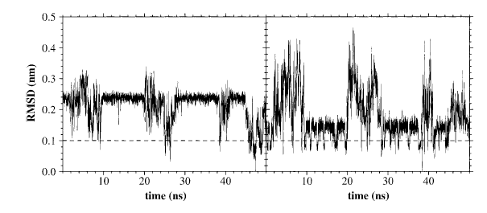

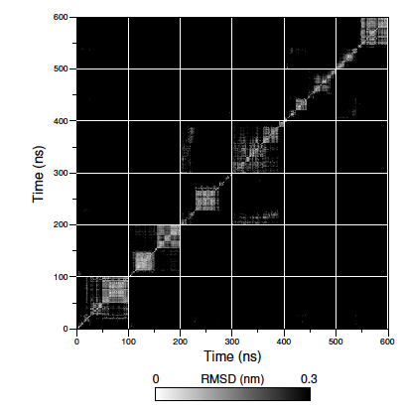
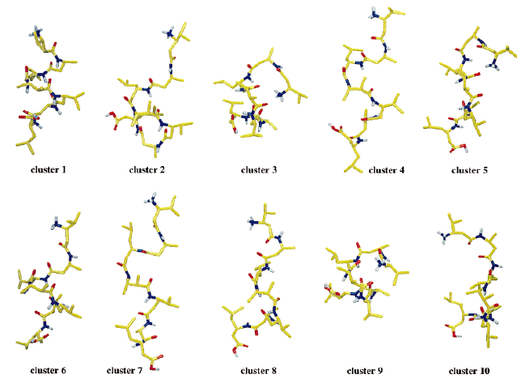
Counting method

Slide 5
Counting method
E
x

Slide 6


Umbrella sampling

Slide 7


Thermodynamic integration
End Point problem
Annihilation

Slide 8

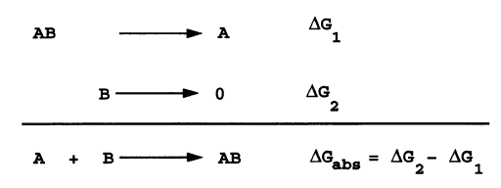
Thermodynamic integration
Double decoupling

Slide 9

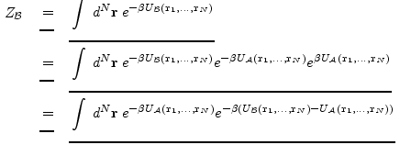
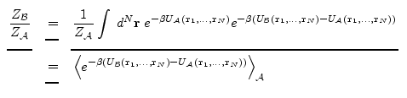

Free Energy Perturbation

Slide 10


Free Energy Perturbation
If A and B is very different
Notes:
the configurations sampled on the potential V^{A} should have a reasonable (at least non-vanishing) probability of ocurring also on V^{B}. This essentially means that thermally accessible regions of the two potentials should have a significant degree of overlap. If not, the result will be a very slow convergence of the average.

Slide 11
TI vs FEP
End Point problem
Notes:
the configurations sampled on the potential V^{A} should have a reasonable (at least non-vanishing) probability of ocurring also on V^{B}. This essentially means that thermally accessible regions of the two potentials should have a significant degree of overlap. If not, the result will be a very slow convergence of the average.
First, there is a possible numerical instability of the free energy formulas associated primarily with the infinite repulsive (1/r¹²) Lennard-Jones term for r=0. That is, in the state where a certain atom has no interactions (a dummy atom) other atoms can lie on top of it, so that the energy of the state where this atom is present with its full interaction would become infinite, as well as its derivative. In the FEP approach this causes no numerical problem in the direction where the real atom is being created, since the exponent in Eq. (1) then becomes minus infinity () and the contribution of such configurations to the free energy difference is zero. Furthermore, in the FEP approach the very end-points (λ=0 or λ=1) are formally only used in one summation direction, i.e. as the initial point of a summation and never as the final point. In TI, on the other hand, the end-point derivatives are often used for the numerical integration of Eq. (7) and an infinite integrand can obviously cause a severe instability. This might be considered to be an advantage of FEP over TI but, unfortunately, this issue is not only a numerical one.

Slide 12
CHARMM Free Energy Calc
Chemical perturbation, where the perturbation being considered is a change in the system's potential function parameters and topology, e.g., CH3OH is "mutated" to CH3CH3
Internal coordinate perturbation, where the perturbation represents a variation in configuration, and the potential function remains the same for the perturbed and unperturbed systems.

Slide 13
Other options?
Knowledge-based scoring approach
Atom-atom contact pairs frequency

