Slide 1
SASSIE 1.0
Outline, new SLD module, and its testing suite

Slide 2
SASSIE outline
SASSIE is a collection of Python and C subroutines;
It is interfaced by a TCL/TK graphical user interface (GUI);
It is used to generate structures, energy minimize atomic coordinates, calculate scattering profiles and analyze results.
SASSIE: A program to study intrinsically disordered biological molecules and macromolecular ensembles using experimental scattering restraints. Computer Physics Communications, 2012, 183(2), 382–389

Slide 3
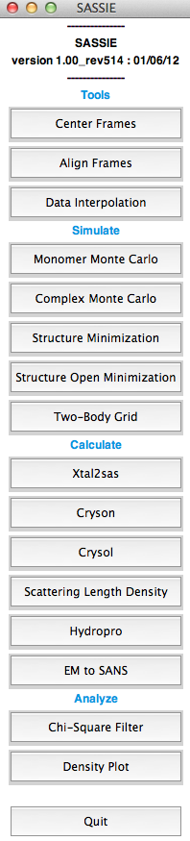
SASSIE workflow
PDB Coordinates
Generate New Structures
Minimize Structures
Calculate Scattering Profiles
Visualize χ² in 2D/3D
Notes:
…
SASSIE has been used to model the SANS of some large and flexible systems, for example gag.

Slide 4
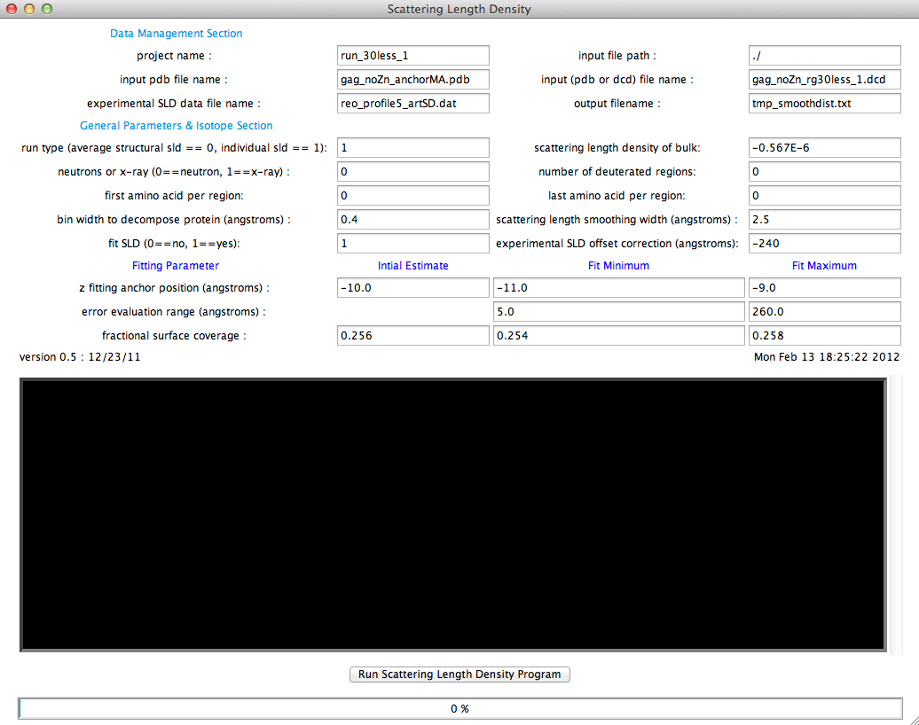
SASSIE SLD module
Notes:
When you click on the button, it will pop up a window asking the user to provide the data file and some general information, for example, …
As an example, I am gonna show some preliminary results for the SLD modeling of a compact form of gag protein.

Slide 5
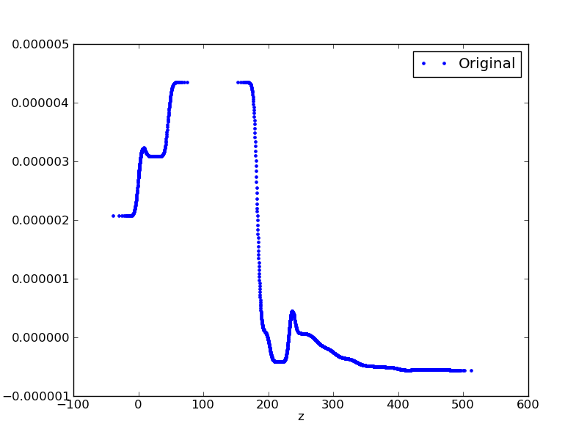
SASSIE SLD modeling on Gag (no NA)
Si
Head group & Interface
Membrane
Head group
Protein & Solvent
Notes:
This is the full length SLD profile of the compact gag based on the experimental data. It is mainly composed of 5 regions…

Slide 6
SASSIE SLD modeling on Gag (no NA)
Head group
Protein & Solvent
Notes:
Of course here we are more interested in modeling the protein region, but it looks like it has some penetration from the protein to the head group.

Slide 7
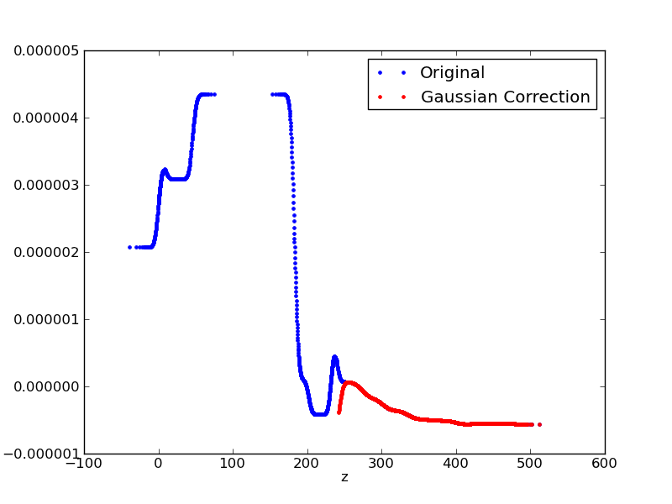
SASSIE SLD modeling on Gag (no NA)
Head group
Protein & Solvent
Notes:
…so first of all, we modeled the head group SLD by a Gaussian, and then subtract this Gaussian from the protein SLD and so we have a red curve here, and the SLD profile will be fit into this red curve.

Slide 8
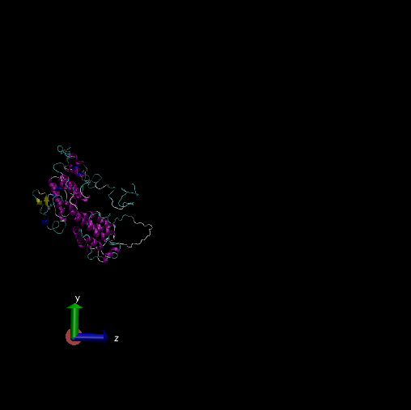
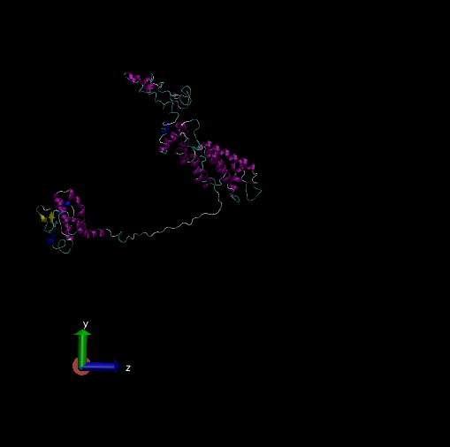
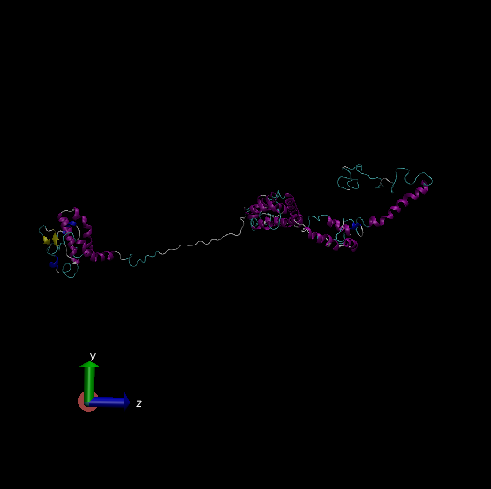
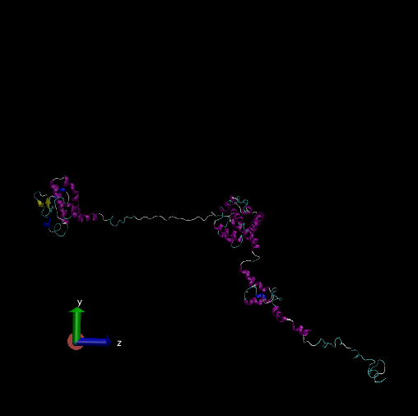
SASSIE SLD modeling on Gag (no NA)
Structure generation:
Rg < 30
52,000 structures
Rg [30,50)
52,000 structures
Rg [50,70)
52,000 structures
Rg ≥ 70
52,000 structures
Notes:
Since the present gag is in a compact form, where the nucleic acid has been removed and the NC domain is likely to be folded back to the membrane and become compact, we first generated 4 structure ensembles based on different Rg values…

Slide 9
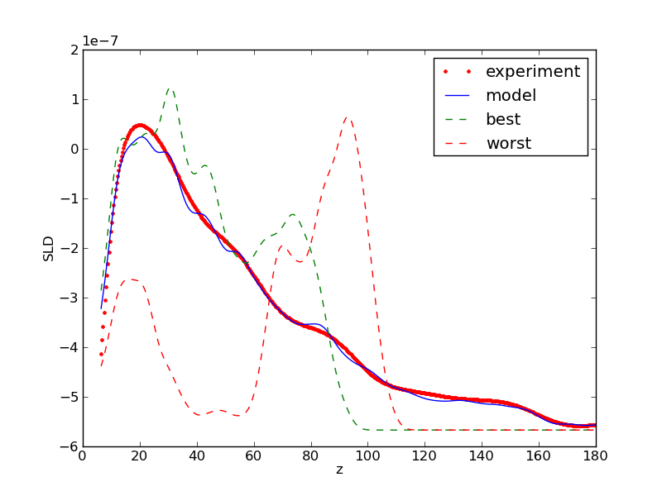
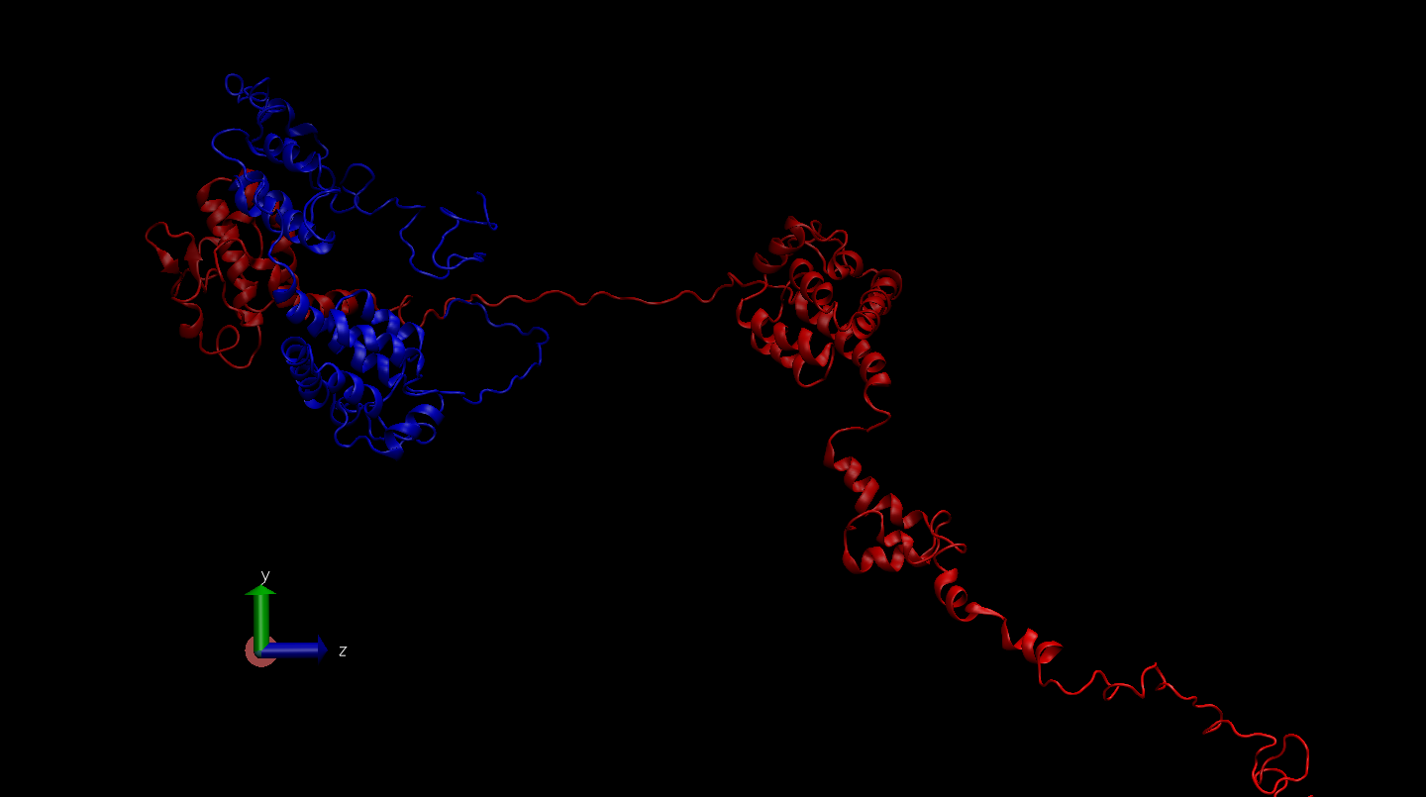
SASSIE SLD modeling on Gag (no NA)
Best
worst
best

Slide 10
SASSIE testing suite
sassie
sasmol
tools
simulate
analyze
…
Notes:
Testing is an important part in modern computer software. It is used to identify the correctness, completeness, security, and quality of the computer software. In modern software development, testing takes about 35-40% of the efforts, and so we want to formally incorporate it into our sassie suite.

Slide 11
SASSIE testing suite
sassie
sasmol
core_testing
tools
simulate
analyze
…
sassie
tools
simulate
analyze
…
data
~20,000 lines of testing codes
~1,000 testing modules

Slide 12
SASSIE testing suite
Hierarchy
Unit test
Capability
Code correctness
Automation
Nosetests
Flexibility
Testing level as required
Integration test
System integration
Machine dependency
Memory issue
Huge data file generated on the fly

Slide 13
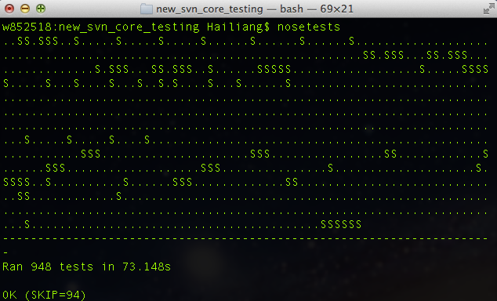
SASSIE testing suite

Slide 14
SASSIE Phase 2
Comprehensive Monte Carlo
Notes:
After adding all the testing codes, SASSIE version 1.0 will be released very soon. And upon release of 1.0, we plan to implement a much more robust and comprehensive MC simulation package to our SASSIE, and here we call it the SASSIE phase 2 plan.

Slide 15
Conformation sampling in SASSIE
Define the intrinsic disordered regions (IDR)
IDR
Randomly choose an angle within the given ranges;
Sample the backbone dihedral angle based on Boltzmann criterion;
Minimize the accepted structures.
Notes:
Phase-2 is related to a very important step in SASSIE, which is ”the conformation sampling”. The systems we are more interested in in SASSIE are generally the large biological complex with a high flexibility. (These systems are more suitable for scattering experiments compared to X-ray diffraction).
……
The most time-consuming part is the energy minimization, which takes seconds to tens of seconds for moderate sized systems. (Even if we only want to minimize the IDR region, it still takes time). So, our target here is to perform a more comprehensive MC simulation which will take an appropriate MC strategy and incorporate the appropriate move sets so that we can somehow circumstance or avoid the energy minimization step.

Slide 16
SASSIE Phase-2
Goal: Study to dictate what direction and how comprehensive our Monte-Carlo program will be;
Statement: For IDR of length N, we need to evaluate the chemical/physical accuracy, sampling efficiency, numerical timing, and overall throughput of our algorithm as a function of our local move basis set.
Notes:
Here is a more formal outline of our phase-2 plan. Our goal is …

Slide 17
Monte Carlo Background
Molecular Dynamics (MD) simulation suffers from time scale limitation (nanosecond);
MC is suitable on time scales much longer than those of MD;
MC is a group of computational methods that move molecules by performing random moves using random numbers;
Metropolis Monte Carlo (MMC).
Notes:
Since phase-2 is closely related to the MC simulation, we will first have a brief background introduction, and have a review of what has already been done for MC simulation of biological systems.

Slide 18


Monte Carlo Background
MMC is a Markov chain Monte Carlo process with the acceptance probability based on the Boltzmann factor:
The detailed balance will be reached after sampling enough configurations, and the thermal-averaged physical property, A, becomes the numerical average of the MC configurations:

Slide 19
Available MC programs
CHARMM (Karplus)
MMC (Mezei)
Rigid body moves
Dihedral angle rotations
Hybrid Monte Carlo
Volume changes
Particle creation and deletion
Rigid body moves
Dihedral rotations for solute (bond lengths/angles fixed)
Force-biased displacement
Cavity-biased insertion
Extension-biased MC
Concerted rotation
Monte Carlo Simulations of Biomolecules: The MC Module in CHARMM, Dinner et al, J Chem Chem, 2005, 27(2), 203-216
Grand canonical ensemble Monte Carlo simulation of a lipid bilayer using extension biased rotations, Jedlovszkya and Mezei, J Chem Phys, 1999, 111, 10770-10773
Notes:
For large biological systems, MC simulation is actually not very popular compared to MD simulation, and currently there are several available programs…and we will have a close look at the move sets and algorithms for these 2 programs.
…
Even if the MC strategy is different between charmm and MMC, when treating large biomolecules (protein), these 2 methods are actually very similar...
…
So, for large biological systems, the dihedral rotation is really the most important move set, and for Charmm and MMC, they both have a sophisticated algorithm for its dihedral rotation.

Slide 20
Historical Motivation for sophisticated dihedral rotations
Notes:
The original motivation for doing this is due to a historical reason when people were doing MC simulation for polymers.
In polymer or polypeptide simulation, if the system is more compact, and when we choose a dihedral angle around the core of the molecule, a small change of a dihedral angle will lead to a big change of the overall conformation and is likely to cause some confliction.

Slide 21
Historical Motivation for sophisticated dihedral rotations
Notes:
This is actually very harmful for MC simulation or minimization, because in MC we want to make each step small so that the energy will be changed gradually and we will have a better acceptance rate.

Slide 22
Historical Motivation for sophisticated dihedral rotations
Concerted Rotation
Notes:
One possible solution is that when we rotate a dihedral bond, the dihedral angles around it will also be rotated cooperatively (CLICK), and this cooperation will make sure conformational change is taking place at a local section of the chain, and the chance of confliction will be much lower. This method is called “concerted rotation” (CLICK).
Now lets go back to our Phase-2 problem (CLICK). For the systems we are interested in SASSIE, the confliction issue probably is not very serious, because the flexible regions of our interested systems are normally not located in the core of a compact molecule. However, we may still use the concerted rotation method to do a local relaxation after rotating a dihedral angle so that we may not need to perform the energy minimization for each individual conformation.
Now let take a close look at this algorithm.

Slide 23
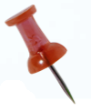
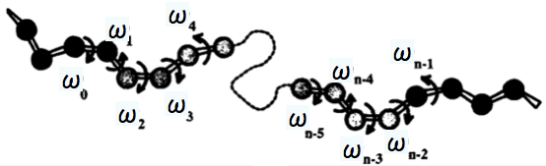
Local Deformation Problem
Ring Closure and Local Conformational Deformations of Chain Molecules, Nobuhiro Go¯, Harold A. Scheraga. Macromolecules, 1970, 3 (2), 178–187
Notes:
The concerted rotation originated from a problem of “ring closure and ….”. In this problem, they were trying to find out that for a chain molecule, if we fixed the relative position and orientation between 2 atoms (CLICK), can we find the solution for the dihedral angles between them? If yes, how many solutions they may have? And how many dof is needed?

Slide 24
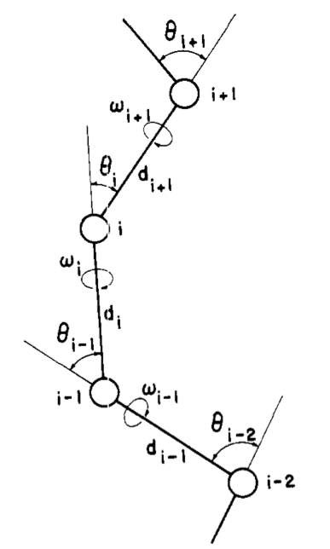
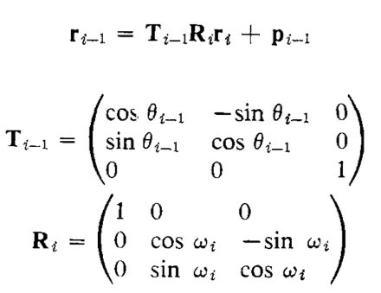
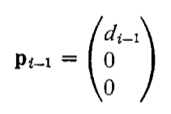
Local Deformation Problem
x_{i}
r_{i}
-> r_{i-1}
y_{i-1}
o
y_{i}
x_{i-1}
o
Ring Closure and Local Conformational Deformations of Chain Molecules, Nobuhiro Go¯, Harold A. Scheraga. Macromolecules, 1970, 3 (2), 178–187
Notes:
This problem looks like easy but actually is not trivial. To solve this problem, we first need to set up the local coordinate system for each individual atom on the chain (CLICK)…
…
Next, for a given point (CLICK), we can set up an equation to transform its local coordinate wrt atom i (CLICK) to that wrt atom i-1 (CLICK). This is actually very easy…

Slide 25
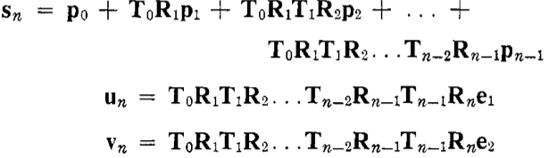
Local Deformation Problem
(s,u,v)
n-6 DOFs
Ring Closure and Local Conformational Deformations of Chain Molecules, Nobuhiro Go¯, Harold A. Scheraga. Macromolecules, 1970, 3 (2), 178–187
Notes:
Next, lets go back to the original problem where we fix the relative position and orientation of the two end atoms 0 and n. Now if we have the local coordinate system of atom n (suv), we can transform it into atom 0 by sequentially applying the previous equation. Now since the relative position and orientation between these 2 atoms is fixed, so the (sn,un,vn) will be a constant in this equation set. Since they are vectors, we have 9 equations, but actually since this is an orthogonal system, the number of independent equations are actually 6. So, in order to solve this equation, we must have 6 independent variables; in other words, if our window size is n, there will be n-6 dof for our problem (CLICK).

Slide 26
Local Deformation Problem
(s,u,v)
ω₅, ω₆ can be separated;
ω₂, ω₃, and ω₄ can be expressed in terms of ω₁;
Ring Closure and Local Conformational Deformations of Chain Molecules, Nobuhiro Go¯, Harold A. Scheraga. Macromolecules, 1970, 3 (2), 178–187
Notes:
Next, Scheraga was trying to solve this equation set for a window size of 6. First, they found that the last 2 angles can be separated from the system and finally they got this single G(omega) equation.
This equation actually has 4 varibles (R1to R4), but Scheraga found that actually …, so now we have a single variable equation, and it seems that our life will be easier, but unfortunately, …

Slide 27
Concerted Rotation
The rotation around seven adjacent dihedral bonds that leaves the rest of the chain unaffected.
Randomly select a dihedral angle from the system (the driver dihedral);
Rotate this driver dihedral by a random angle;
Concertedly rotate its adjacent 6 dihedral angles.
A concerted rotation algorithm for atomistic Monte Carlo simulation of polymer melts and glasses , L.R. Dodd et al., Molecular Physics, 1993, 78(4), 961-996
Notes:
Scheraga’s local deformation problem was first systematically introduced into MC simulation about 20 years ago, which is called concerted rotation. For example, Dodd defined the concerted rotation as …

Slide 28
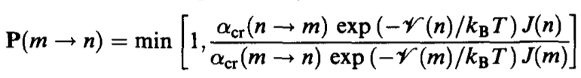
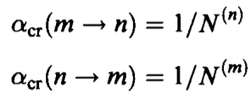
Concerted Rotation
Acceptance criterion:
A concerted rotation algorithm for atomistic Monte Carlo simulation of polymer melts and glasses , L.R. Dodd et al., Molecular Physics, 1993, 78(4), 961-996
Notes:
This concerted rotation was introduced in MC with the following acceptance criterion. This acceptance criterion is a little bit different from the standard acceptance criterion we showed before, because it has to be modified to satisfy the detailed balance. For example, a Jacobian has to be included because the concerted rotation involves a coordinate transformation from omega to (suv), and alpha(cr) is the element of the underlying matrix of Marchov chain, and …

Slide 29
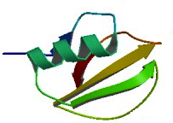
Concerted Rotation
Application on protein
Chymotrypsin inhibitor
Move Sets:
Displacements of single atoms (ATOM);
Individual rotations of all freely rotatable dihedral angles (IROT);
Concerted rotations which the peptide bond (ω) dihedral angles either fixed (CRT1) or not fixed (CRT2).
Local Deformations of Polymers with Nonplanar Rigid Main-Chain Internal Coordinates, A.R. Dinner, J. Comp. Chem., 2000, 21(13), 1132-1144
Notes:
The MC simulation with concerted rotation has been implemented in CHARMM to model some protein systems, for example…

Slide 30
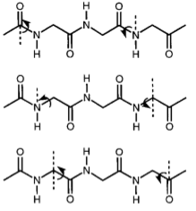
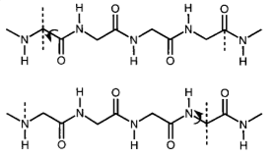
Concerted Rotation
Application on protein
CRT1 CRT2
Local Deformations of Polymers with Nonplanar Rigid Main-Chain Internal Coordinates, A.R. Dinner, J. Comp. Chem., 2000, 21(13), 1132-1144
Notes:
This picture shows how they selected the dihedral window for the concerted rotation.

Slide 31
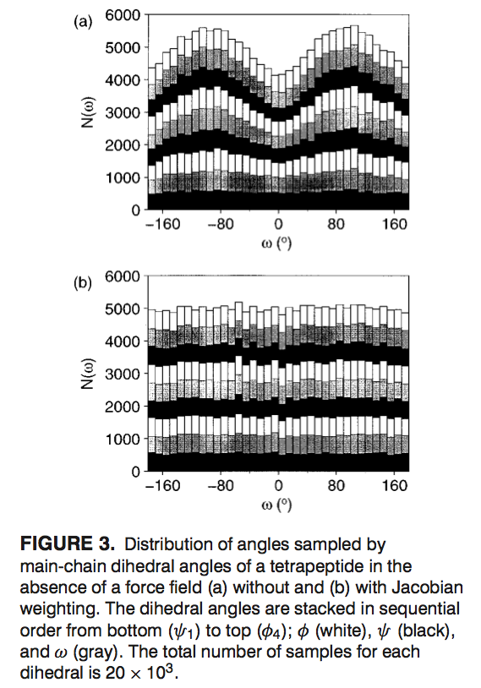
Concerted Rotation
Application on protein
Test of detailed balance for Jacobian weighting:
Test on a tetrapeptide in absence of force field, with and without Jacobian weighting.
If detailed balance is met, the main chain dihedral angle should distribute uniformly.
Local Deformations of Polymers with Nonplanar Rigid Main-Chain Internal Coordinates, A.R. Dinner, J. Comp. Chem., 2000, 21(13), 1132-1144

Slide 32
Concerted Rotation
Application on protein
The concerted rotations improved the rate at which the main-chain dihedral angles explore their accessible regions;
The concerted rotations reduced the computational time for the MC simulation.
Local Deformations of Polymers with Nonplanar Rigid Main-Chain Internal Coordinates, A.R. Dinner, J. Comp. Chem., 2000, 21(13), 1132-1144

Slide 33
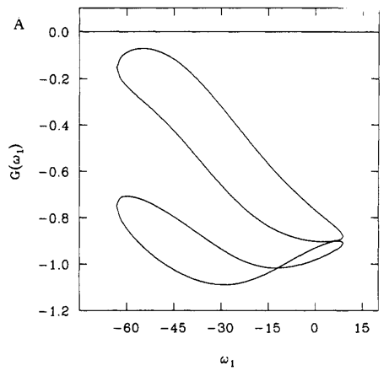
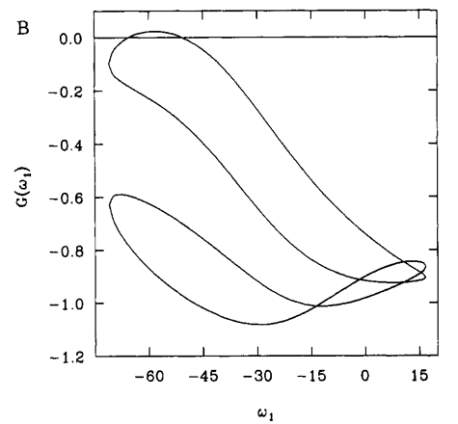
Concerted Rotation
Angle variations
Chain Closure with Bond Angle Variations, RE Bruccolerit and M Karplus , Macromolecules, 1985, 18, 2161-2173
Notes:
However, there is still a problem as we mentioned before: in some cases it is possible that…
Later, Karplus found out that this problem can normally be solved by provide a small variation to the bond angle within the range of concerted rotation.

Slide 34
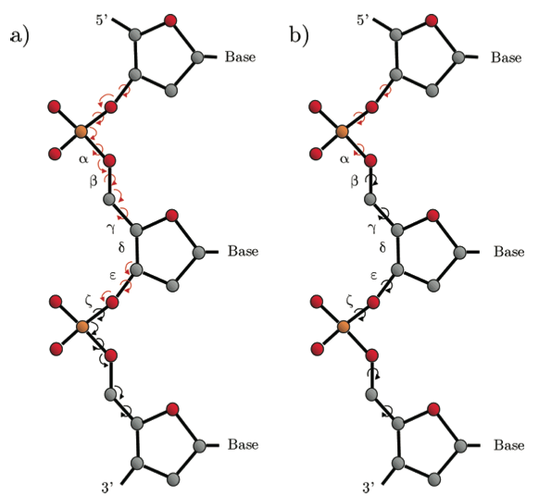
Concerted Rotation
Angle variations and application on DNA
With angle variation
Without angle variation
Monte Carlo Backbone Sampling for Nucleic Acids Using Concerted Rotations Including Variable Bond Angles, Ulmschneider and Jorgensen , J. Phys. Chem. B, 2004, 108, 16883-16892
Notes:
The angle-variation algorithm is covering a significantly wider range of structures than the CR method.

Slide 35
Extension biased rotations
A variable step size method;
The closer the rotated atoms are to the axis of rotation, the larger we set the angle range of random rotation;
Grand canonical ensemble Monte Carlo simulation of a lipid bilayer using extension biased rotations, Jedlovszkya and Mezei, J Chem Phys, 1999, 111, 10770-10773
Notes:
Actually the concerted rotations is not the only method to solve the local deformation problem. In MMC, there is an algorithm called…
…
The principle underlying this method is rather simple……In other words, the smaller the extension of the molecule perpendicular to this axis is, the larger we set the angle range of random rotation.

Slide 36
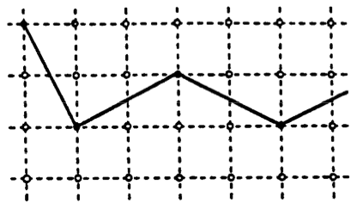
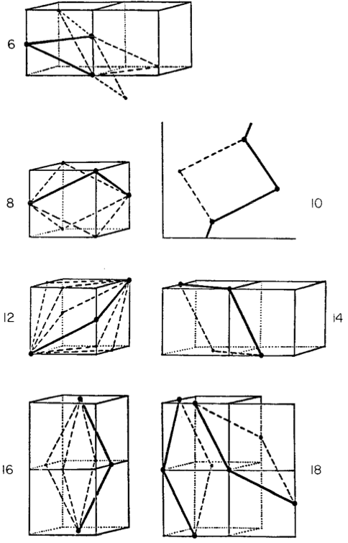
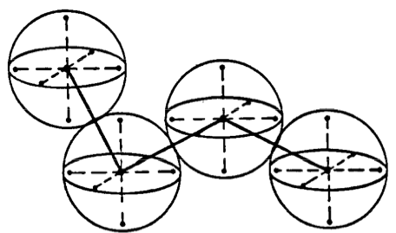
Lattice Model
3.8 A
1.7A
Dynamic Monte Carlo Simulations of a New Lattice Model of Globular Protein Folding, Structure and Dynamics, J Skolnick et al, J. Mol. Biol. 1991, 221,499-531
Notes:
In SASSIE Phase 2, we are not only trying to do the local relaxation after a dihedral rotation; we are also trying to include more comprehensive move sets so that our program will become more flexible and adaptable. So I am gonna introduce several more MC move sets and methods in the next couple of slides.
One is called lattice model. It is actually a CG model which will place the protein CA atoms on a 3D grid. The grid spacing is 1.7A, and the CA atoms are sequentially placed on the (2,1,0) grid points so that the atomic distance will be 3.8A, which is the standard CA distance in protein. Each residue is composed of 7 grid points so that the overlap could be avoided during the simulation. The move set for this CG model can be defined based on the geometry of its adjacent grid points.

Slide 37
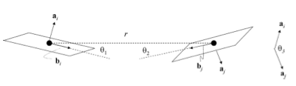

Nucleic Acid CG Model
Influence of mobile DNA-protein-DNA bridges on DNA configurations: Coarse-grained Monte-Carlo simulations, Renko de Vries l, J. Chem. Phys. 2011, 135, 125104
Notes:
Beside CG model for protein, there are also some CG model for nucleic acid which has been used for MC simulation. For example,

Slide 38
Flexible-Meccano
Amino acid-specific φ/ψ combinations are randomly extracted from a library of loop structures built from 500 high-resolution x-ray structures;
A simple exclusion term is applied to avoid collapse within the chain;
This method is not chain-length dependent allowing it to be used for arbitrary proteins.
A structural model for unfolded proteins from residual dipolar couplings and small-angle x-ray scattering, Bernado et al, PNAS, 2005,102, 17002–17007

Slide 39
For SASSIE Phase 2
Extension biased rotations
Dihedral sampling
Concerted rotations
Local relaxation
Flexible-Meccano
Random sampling
Coarse grained model
Nucleic acid
Notes:
As a summary, in SASSIE Phase 2, we may include some of the above move sets or methods to make our SASSIE more comprehensive.

Slide 40
Next…
Investigate the MC source code of CHARMM and MMC;
Initially select the move sets and design the MC strategy for the present IDR problem;
Pseudo-coding, coding, and testing;
Evaluate the chemical/physical accuracy, sampling efficiency, numerical timing, and overall throughput of our algorithm;
Optimize the MC specification (the move sets selection, weights, the acceptance criterion, and etc);
CUDA implementation;
…

Slide 41
Thank you!

