Slide 1
OpenMM workshop
March 2012, Stanford
Notes:
The talk focused on the API, but I am trying to learn the CUDA…

Slide 2
OpenMM outline
OpenMM is a software package for executing molecular simulations on high performance computer architectures.
It consists of two parts:
    A set of libraries (wrappers in C, Python, Fortran)
    An “application layer” (Python library)
It has a strong emphasis on hardware accelerations
Notes:
1. It can do energy minimization, MD simulation, and free energy evaluation, but not MC.
…
OpenMM is written in C++
2. First, there is a set of libraries that the users can use to customize the force evaluation, numerical integration, energy minimization, etc. These libraries are actually an interface that will allow the developers to easily add simulation features to their programs.
Second, there is an “application layer”. This is a set of Python libraries providing a high level interface for running simulations. This layer is targeted at higher level of computational chemists who just want to run simulations, and who are not interested in programming.
…

Slide 3
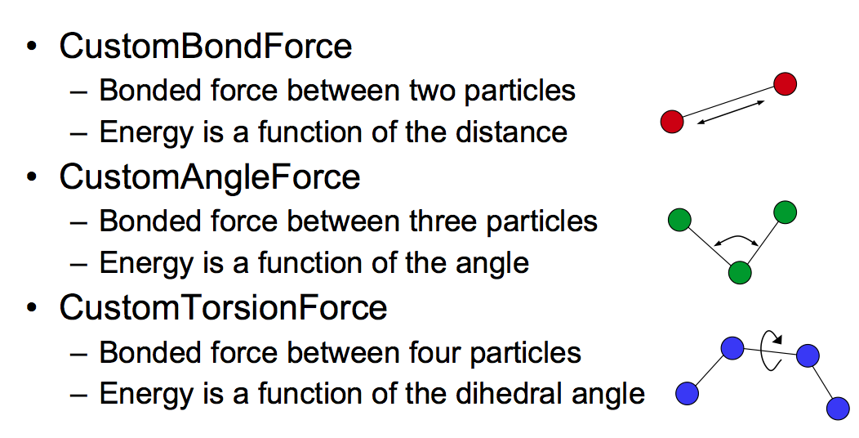
Custom Force
Notes:
They claimed that no other software provide the users such a freedom to build their customized forces.
…
This provides great flexibility to the coarse grained modeler

Slide 4
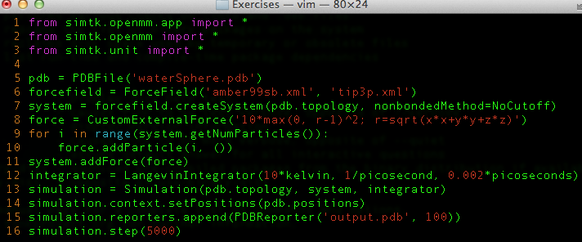
Custom Force

Slide 5
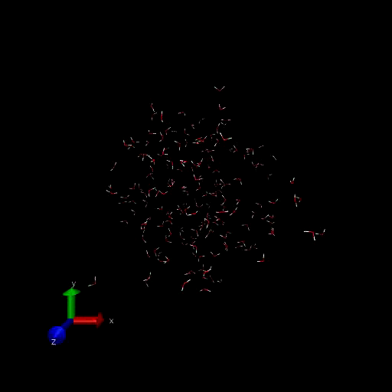
Custom Force
Notes:
This provides great flexibility to the coarse grained modeler

Slide 6
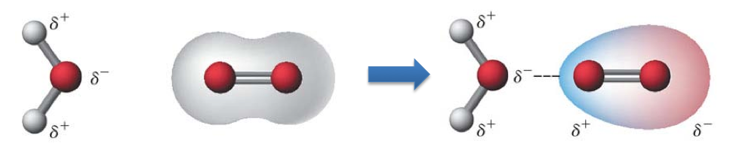
AMOEBA
AMOEBA is one of several force fields with the ability to describe electronic polarization.
AMOEBA gives improved agreement with the ab initio gold standard.
OpenMM uses the GPU to evaluate the AMOEBA interactions for an enormous performance increase.
Notes:
`…
Polarizable force fields have high computational cost.

Slide 7
OpenMM classes and architecture
System
Force
Context
Integrator
State
Notes:
Left
The public API of OpenMM is based on a small number of classes:
A System specifies generic properties of the system to be simulated: the number of particles it contains, the mass of each one, the size of the periodic box, etc.
After the system is built, he Force objects can be added to a System and define the behavior of the particles.
Context contains all state information of the system (positions, velocities, other parameters)
Integrator includes LangevinIntegrator, VerletIntegrator, and BrownianIntegrator.
One thing very important in OpenMM is that the API cannot provide direct access to state information (particle positions, velocities, etc.) at all times…
State: a snapshot of the state of the system (for fast GPU reading in a BULK)
The public API layer consists of the classes you access when using OpenMM in an application: System; Force and its subclasses; Integrator; and Context.. These classes define a public interface but do no computation.
…
The “implementation” layer mirrors the public API classes and bridges API and and kernals.
…
The kernel implementation is contained in the last 2 layers.

Slide 8
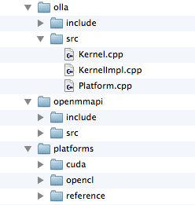
OpenMM classes and architecture

Slide 9
Hardware acceleration
References
CUDA
OpenCL
AMOEBA only in CUDA
Custom non-bonded forces has better performance in OpenCL
Notes:
They are coded at the lowest level of kernal implementation
…
References: seriel computation
CUDA:
OpenCL:

Slide 10
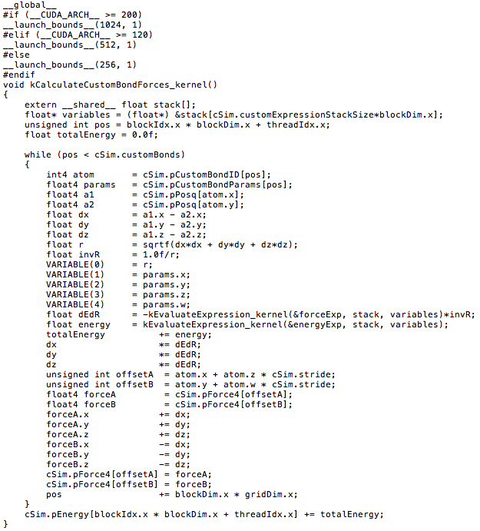
CUDA snapshot

Slide 11
OpenMM tests
Unit test
    Validate specific features
    e.g. Simulate a single harmonic bond with a verlet integrator, compare to the analytical results
    Included with the source code
Notes:
Another thing I am interested in the software testing they have reported. They have a specific talk on the unit and integration tests of OpenMM, but actually I found from the talk and source code that their testing is not very systematic like ours.
First of all, they are not function/module based tests. The unit tests they provided only.

Slide 12
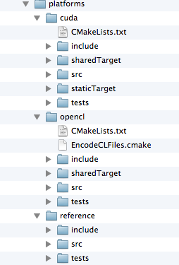
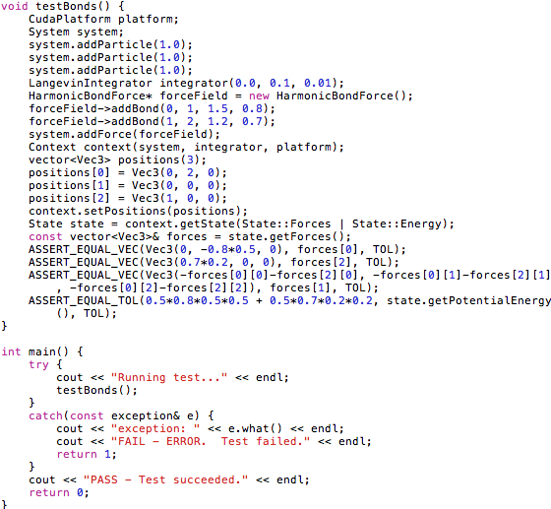
OpenMM tests
Unit test

Slide 13
OpenMM tests
Unit test
    Validate specific features
    e.g. Simulate a single harmonic bond with a verlet integrator, compare to the analytical results
    Included with the source code
System tests
    Validate specific features
Platform consistency tests
    Check that results computed with Reference/CUDA/OpenCL agree
Stochastic tests
Notes:
System tests are not included in the source code
…
Stochastic test: no random seed. If the difference is very different from the the variant, it will give a warning.

