Slide 1
SANS modeling of Integrase-DNA complex by FFT-docking

Slide 2




FFT-docking
O(N³)
0
1
rou
O(ln(N))
1
delta
Molecular surface recognition: determination of geometric fit between proteins and their ligands by correlation techniques. Katchalski-Katzir E et al., Proc Natl Acad Sci USA 1992, 89: 2195–2199

Slide 3
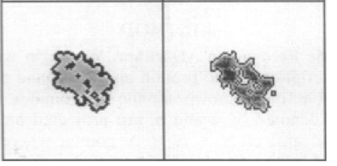
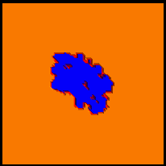
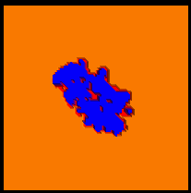
FFT-docking
Molecular surface recognition: determination of geometric fit between proteins and their ligands by correlation techniques. Katchalski-Katzir E et al., Proc Natl Acad Sci USA 1992, 89: 2195–2199

Slide 4
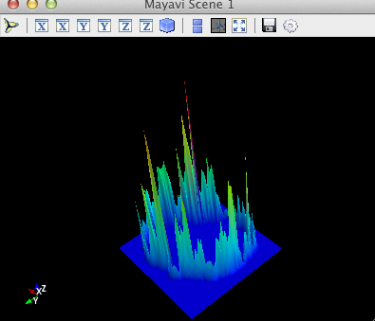
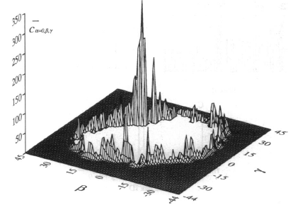
FFT-docking
Molecular surface recognition: determination of geometric fit between proteins and their ligands by correlation techniques. Katchalski-Katzir E et al., Proc Natl Acad Sci USA 1992, 89: 2195–2199

Slide 5
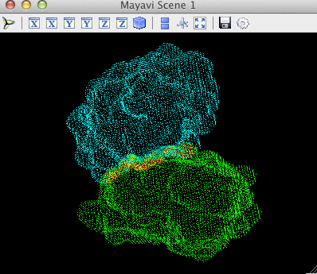
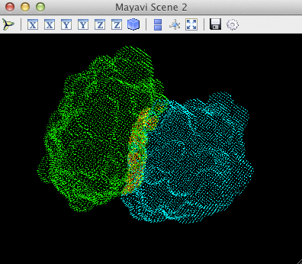
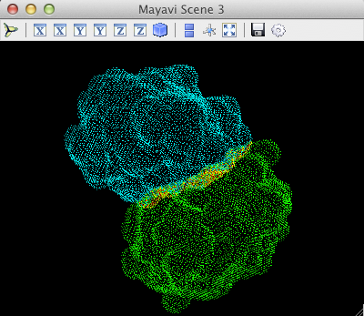
FFT-docking
Molecular surface recognition: determination of geometric fit between proteins and their ligands by correlation techniques. Katchalski-Katzir E et al., Proc Natl Acad Sci USA 1992, 89: 2195–2199

Slide 6
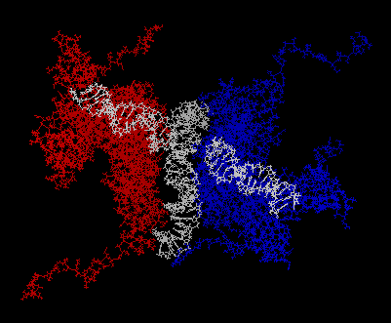
FFT-docking of Integrase-DNA
3
1
2

Slide 7
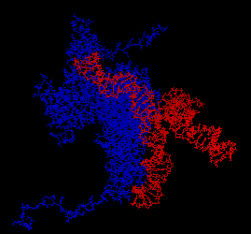
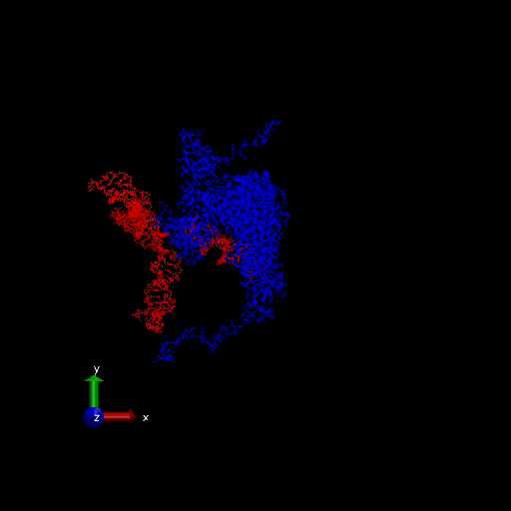
FFT-docking of Integrase-DNA
Rg: 31A - 51A
Choose 1 largest, 3 medium, 1 smallest Rg

Slide 8
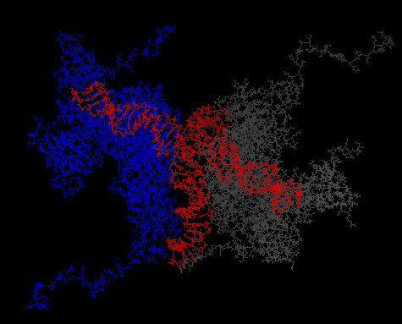
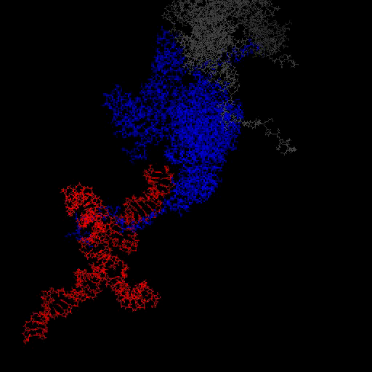
FFT-docking of Integrase-DNA

Slide 9
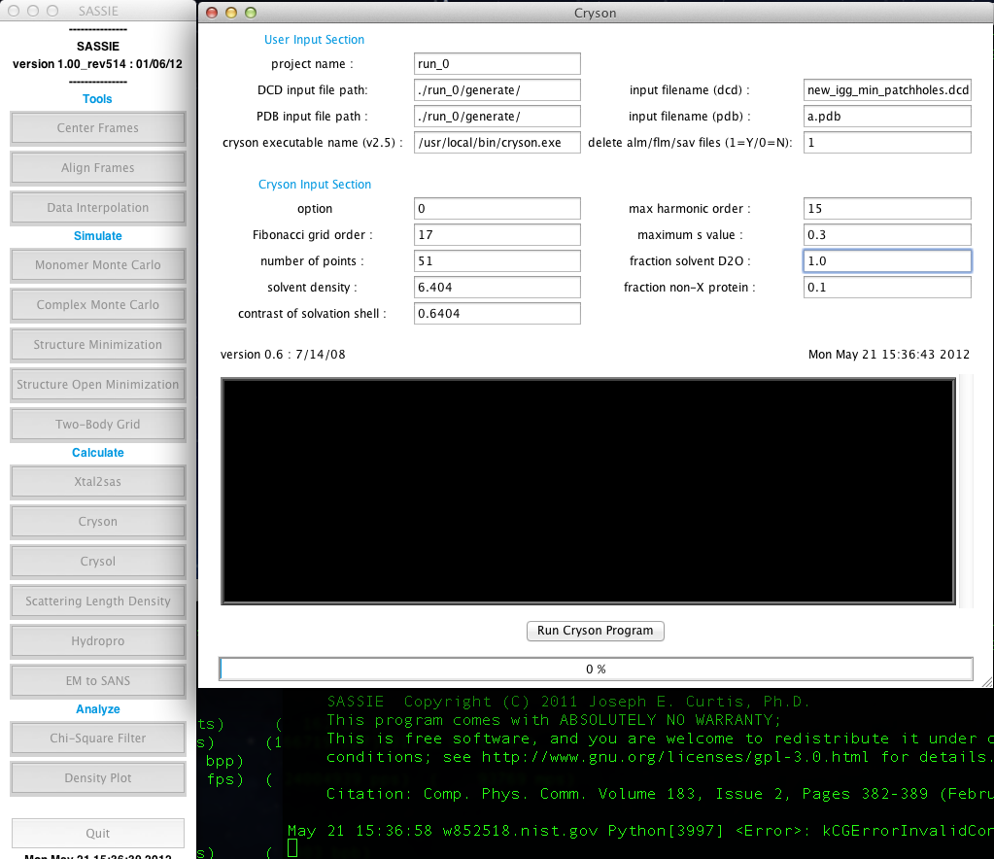
SANS modeling of Integrase-DNA
0% D2O
20% D2O
80% D2O
95% D2O

Slide 10
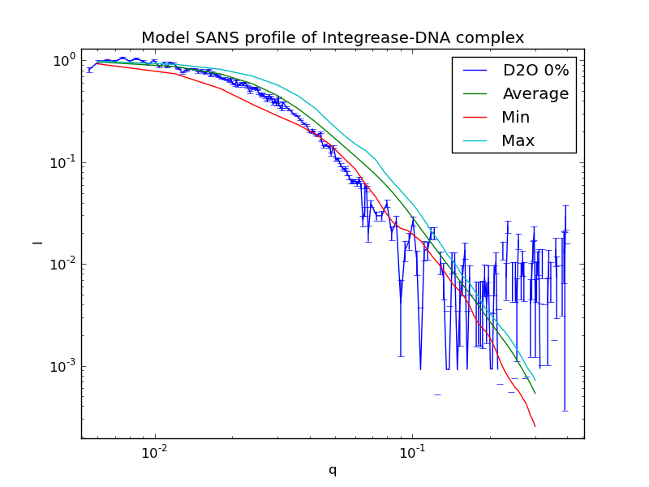
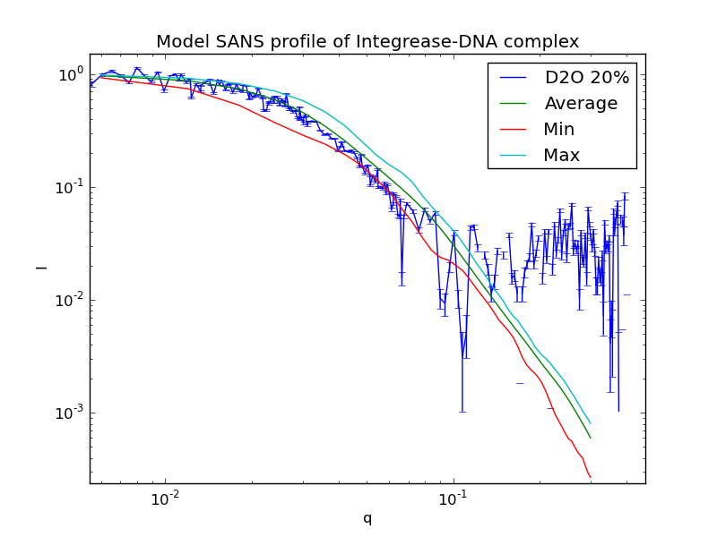
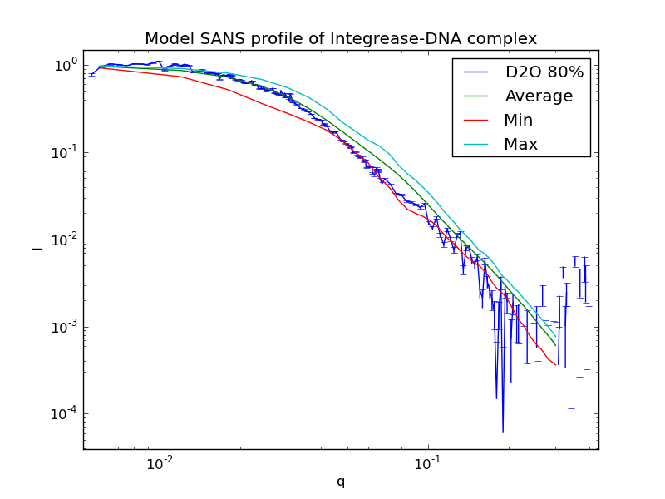
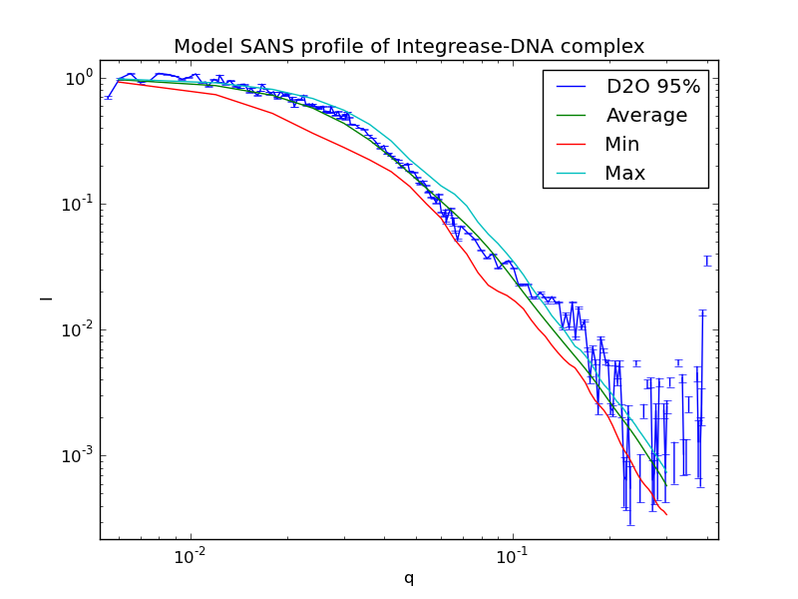
SANS modeling of Integrase-DNA

